Slide 1
Senior Scientist Grant Program Manual
Project: Automated on-line monitoring system of incoming ore flows for mining and processing plants
second half of 2017
Almaty 2017

Slide 2
Automated on-line monitoring system of incoming ore flows for mining and processing plants
General information
Sub-project: Automated on-line monitoring system of incoming ore flows for mining and processing plants
Project Leader – Doctor of Technical Sciences, U. Tukeyev
Grant recipient – «TST-16» LLP
Business partner – Systemotechnika LLP
Notes:
Рисунок 4

Slide 3
Automated on-line monitoring system of incoming ore flows for mining and processing plants
PROBLEM: MANAGEMENT’S EFFICIENCY FOR MULTI-FLOW ORE ENRICHMENT SYSTEM
The practical operational technology for measuring the quality of processed ore is oriented at fine-fraction ore flows and are used in a single-flow scheme of ores supply for enrichment.
However, single-flow ore supply scheme does not provide the maximum loading of enrichment plants equipment.
At multi-flow ore supply scheme, fine-fractioned ore flows are obtained after crushing when it is hard to distinguish in a ore flow which ore comes from a certain mine.
Thus, there is a problem: prior to crushing it is hard to quickly measure the quality of ore from pits, and after crushing it is hard to distinguish which ore came from a certain mine.
This problem of operational monitoring of input ore flows at multi-flow ore supply scheme for enrichment has still not been resolved.
Notes:
Рисунок 4

Slide 4
Automated on-line monitoring system of incoming ore flows for mining and processing plants
THE PROPOSED TECHNOLOGY
The essence of technology is considering temporal dependencies of discrete flows of ores wagons from different quarries in the mixed output flow of the crushing shop.
Measuring of quality of fine-fraction ore flow at crushing shop takes place.
Then back in time (temporal) projecting of measured quality of ore into discrete flows of wagons from the quarries takes place.
That is how the real-time identification of the quality of wagon ores of certain quarries takes place.
Notes:
Рисунок 4

Slide 5
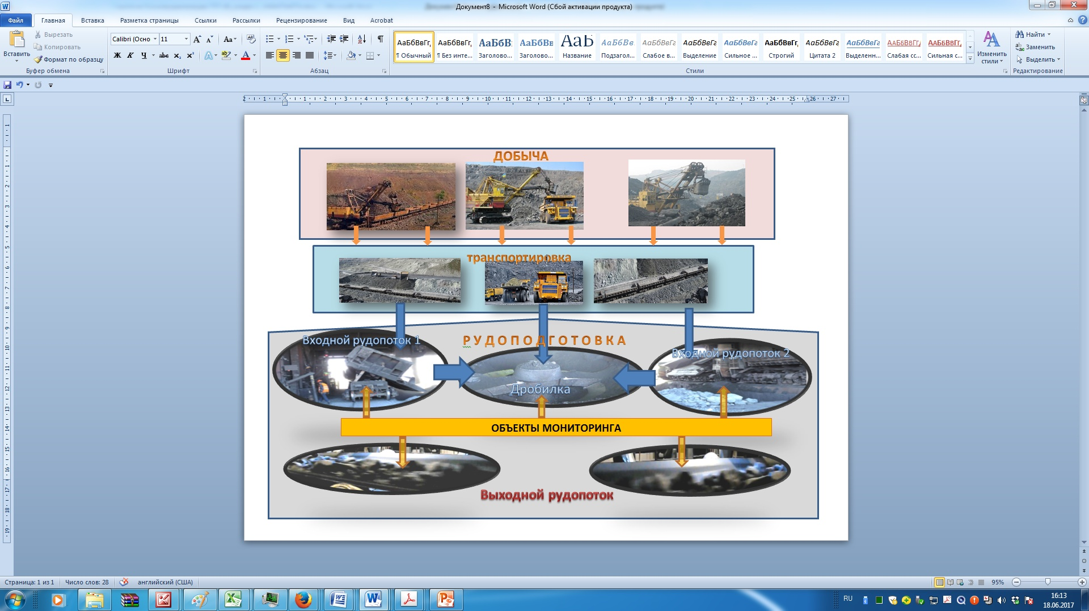
Automated on-line monitoring system of incoming ore flows for mining and processing plants
Objects of monitoring
Конвейер
Конвейер

Slide 6
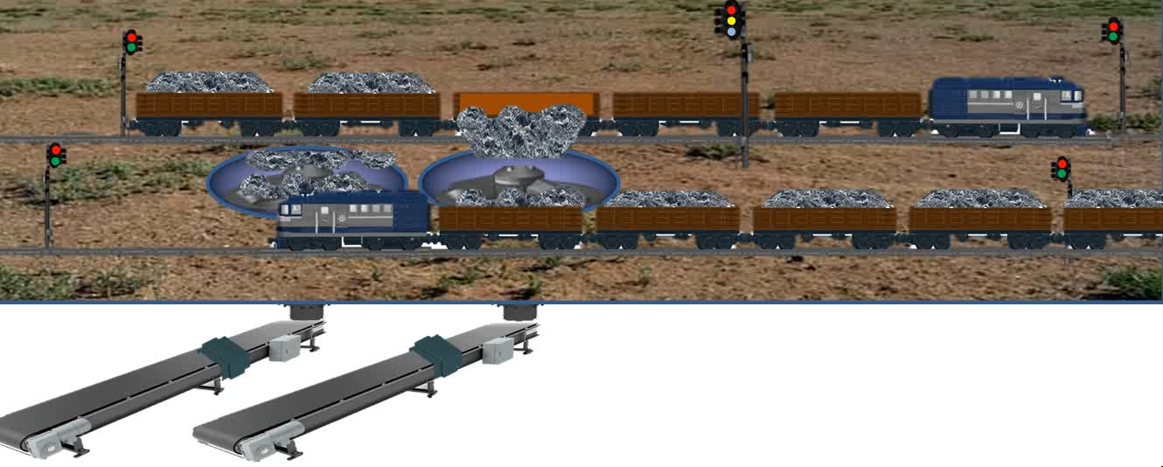
Automated on-line monitoring system of incoming ore flows for mining and processing plants
Receiving ore from the mines to the dressing plant (DP). Positioning of the formulations in the unloading zone
Semaphores
Analyzer
Scales
Notes:
Рисунок 4

Slide 7
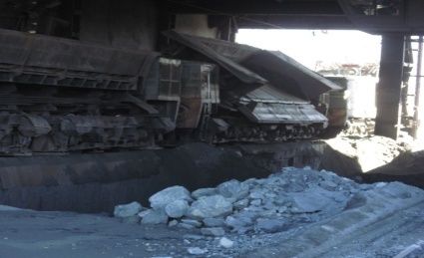
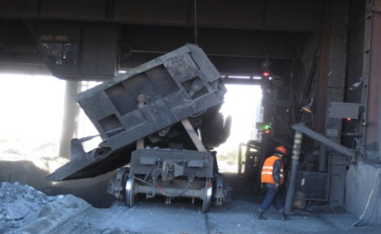
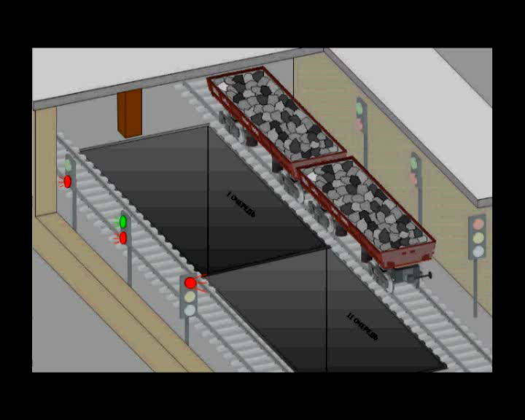
Automated on-line monitoring system of incoming ore flows for mining and processing plants
Receiving ore from the mines to the dressing plant. Unloading into the hoppers of mills
Dump to the hopper 1
Dump to the hopper 2
Analyzer
Analyzer
Scales
Scales

Slide 8
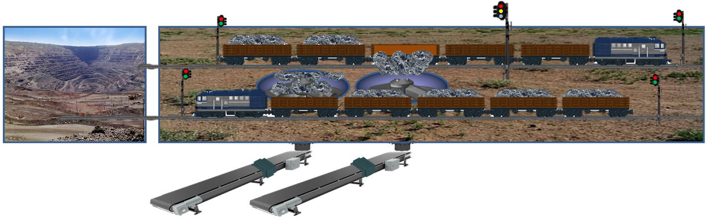
Automated on-line monitoring system of incoming ore flows for mining and processing plants
Structural scheme of information gathering and formation of the operational report of monitoring
Mine
Unloading area
Chronology ore carriers arriving at the factory
Chronology of movement in the unloading area
Analyzer
Scales
Quality control and dynamics of the ore flow after the LCP
Temporal pattern of movement in the unloading area
Analytics block: Disintegration of the flow of ore mixture after large crushing plant (LCP) on the basis of belonging to ore mines
Temporal pattern of work flow transport system
of the LCP
Summary results of the operational monitoring of the inlet ore flows of DP
The block of the account of quality and volume of ore accepted on LCP
Technological scheme of the monitoring object
Notes:
Рисунок 4

Slide 9
Automated on-line monitoring system of incoming ore flows for mining and processing plants
The analysis scheme in the analytics block of the AS OMQO
Блок «Вертушка»
Блок «Свал»
Блок «Очередь»
Блок «Внешнее ПО»
Пауза
Время между вертушками
Количество вагонов
Формирование количества вагонов в вертушке
Занятость пути = 1
Занятость пути = 1
Цикл [0,n]
Пауза
Задержка на выдачу сигнала «Движение на пути»
Движение на пути = 1
Пауза
Количество повторений равно сгенери-рованному количеству вагонов
Длительность позиционирования вагона над бункером
Команда на свал = 1
Движение на пути = 0
Пауза
Счетчик вагонов
Задержка на подачу команды на свал
Команда на свал = 1
Пауза
Очередь Х. Команда на свал = 1
Подсчет количества сваленных вагонов
Задержка сигнала ответного
Выбор очереди для свала
Опрокид = 1
Пауза
Очередь Х. Опрокид = 1
Длительность разгрузки вагона
Выбор очереди для свала
Опрокид = 0
Очередь Х. Опрокид = 0
Пауза
Задержка снятия команды на свал.
Команда на свал = 0
Очередь Х. Команда на свал = 0
Пауза
Задержка на выход вертушки
Занятость пути = 0
Занятость пути = 0

Slide 10
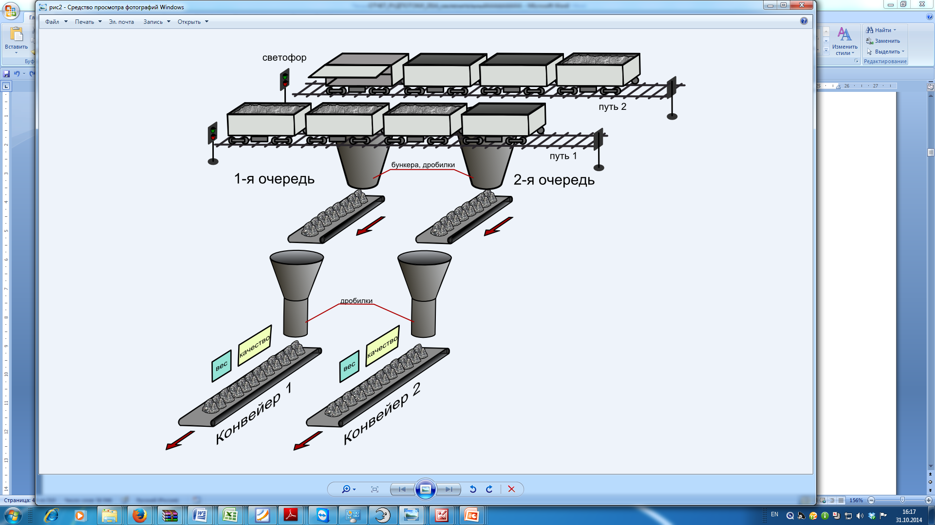
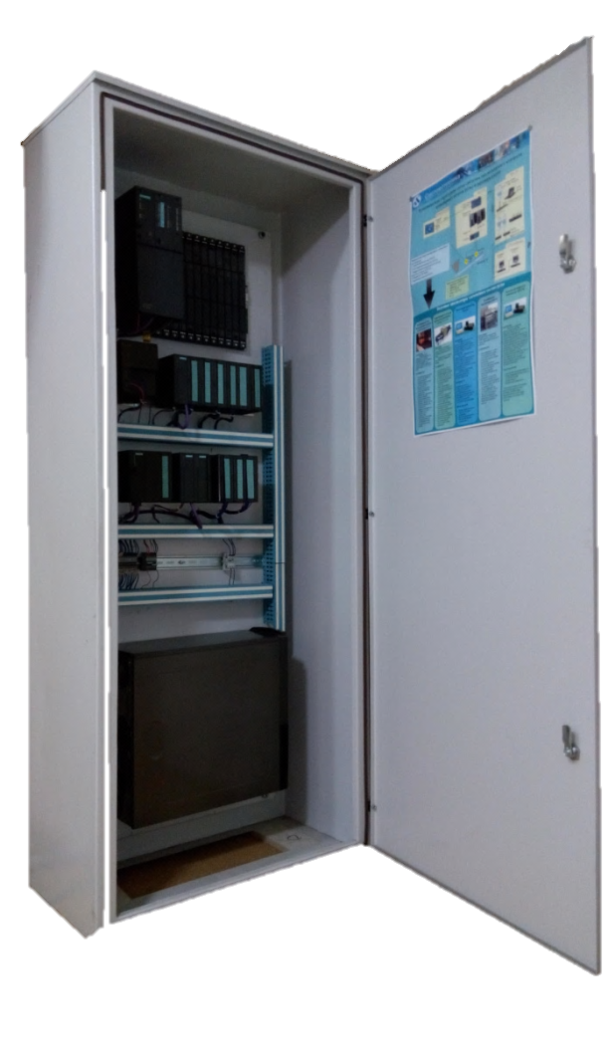
Automated on-line monitoring system of incoming ore flows for mining and processing plants
Scheme of setting and configuring the monitoring system on the basis of a specialized stand
For the standard train for each vagon before unloading in the hopper are determined: the weight of the ore, the content of the useful component, the mine, the number of wagons and the like
Etalon train
traffic light
Railroad 2
Reference data
bunkers, crushers
railroad 1
Monitoring data
Monitoring data
Service of adjusting the parameters of the analytical unit of the AS OMQO using the simulation model of processes at monitoring sites
АS ОМQO
Analytical block AS OMQO
Adjusted parameters of the analytical block

Slide 11
Automated on-line monitoring system of incoming ore flows for mining and processing plants
Advantages of the proposed technology
The time for determining the quality of ores from mines is reduced: traditional two or three days are reduced to real time, i.e. to the rate of the technological process.
Operational management of the mine - crushing - enrichment processing chain is ensured.
A real informational basis is created for objective self-supporting relationships between the mining and beneficiation

Slide 12
















Automated on-line monitoring system of incoming ore flows for mining and processing plants
Project №APP-SSG-16/0330P
Integrated technology assessment on 06/11/2017
Determining the viability of technology
Perception of value
Characteristics
Interview
Peculiarities
Benefits for customers
Technology
(+3 & -3)
Competitors
Importance for client (+3 & -3)
Customer Needs
Technical
Monitoring of input ore flows quality at concentrators in real time mode.
Reduced hardware monitoring costs
Online management of technological chain "mine-crushing-enrichment"»
Domestic producer
Online record f data volume on quality of ore flows from mines
Reduced time to determine the quality of ores from mines
Production control and quality management of finished products
Improves coordination and increases operation speed of technological sections of concentrators.
+3
+3
+2
+1
-1
-1
• TECHNOROS LLC
• Uraludoavtomatika LLC
Salikhov Zufar Garifullovich. Doctor of Technical Sciences, Professor, Honored Scientist of Russia, member of RANS and International Academy of ENPS, Chief Researcher of Institute of Control Sciences of RAS.
Market
Problems
Problems solutions
Solution – market conformity
Degree of technology readiness
Problems
Solution
Segments of market
The technologies applied in practice are oriented at monitoring of small-fractional ore flows and to single-flow scheme of their supply for processing.
Use of the proposed technology, which provides on-line monitoring of incoming flows at concentrators in real time mode
The technology is under fine tuning process (final stage). Design and development of software for automated monitoring system has been completed. The next step is hardware package purchase and industrial approbation of technical solutions and equipment in industrial conditions of a potential buyer of the technology - "SSGPO" JSC.
Extraction and processing of mineral raw materials
Manufacture of building materials
Users
Value propositions
Concentrators
Building materials production companies
The proposed technical solutions complement the existing basic methods for controlling the characteristics of ores supplied for processing, which allows to improve the efficiency and accuracy of raw material estimates and the efficiency of its processing.
Risks and barriers
Co-investors / partners
No approbation under industrial conditions
Emergence of direct competitors
Dependence on the financial state of concentrators
Systemotechnika LLP is the Co-investor of the Project (co-financing of 5,000,000 KZT). Supply of scientific and patent database of the project
SSGPO JSC: provision of a site for industrial testing of the subproject results
Status of intellectual property
There are 2 patents, the patent holder “Systemotechnika" LLP is working on concluding agreement on assignment of rights to technology. Application was filed for obtaining a patent for invention: “System of online automatic monitoring of ore flow characteristics in preparation for enrichment"
Partners
Systemotechnika LLP
SSGPO JSC
Notes:
ПО МАТЕРИАЛАМ TECHIN2B

Slide 13
Automated on-line monitoring system of incoming ore flows for mining and processing plants
Work plan for the second half of 2017
Works | 1 quarter | 2 quarter | 3 quarter | 4 quarter
Development of technical support (ТS)
Development of mathematical support
Development of application software (software)
Correction of the hardware and software platform
Acquisition and installation of cabinet designs sample base-line monitoring of DP production intensity systems
Completion of the system software platform
Installing software on the base of technologists workstations

Slide 14
Automated on-line monitoring system of incoming ore flows for mining and processing plants
Results of works for the second half of 2017
Works | QUARTER |  | Status | RESULTS
 | 3 | 4
Development of technical support (ТS) |  |  | Done 100% (previously - 70%) | Technical documentation for the level of basic automation, based on programmable logic controllers
Development of mathematical support |  |  | Done 100% (previously - 40%) | Models and algorithms of the subsystems for data collection and situational analysis
Development of application software (software) |  |  | Done 100% (previously - 30%) | Application software for the basic control level and technological level
Correction of the hardware and software platform |  |  | Done 100% (previously - 0%) | The specifications for the purchase of equipment have been developed
Acquisition and installation of cabinet designs sample base-line monitoring of DP production intensity systems |  |  | Done 20% (previously - 0%) | The market was investigated. The potential supplier of cabinet designs of the system of the AS ICQO - LLP "EnergyAutomation" is defined
Completion of the system software platform |  |  | Done 20% (previously - 0%) | The analysis of the market is carried out. A range of potential suppliers has been identified.
Installing software on the base of technologists workstations |  |  | Done 15% (previously - 0%) | Trial installation and autonomous testing of the main components of distribution package of the developed AS OMQO application software was conducted on AS OMQO hardware model under the field conditions of TST-16 LLP Installation will be made after completion of the work on the assembly and installation of cabinet structures

Slide 15
Automated on-line monitoring system of incoming ore flows for mining and processing plants
Activities to ensure the functioning of the project team in the framework of TST-16
Name of events / works | Results
Purchase of computers, office equipment, office supplies Purchase of office furniture Purchase of translation services Purchase of postal services | A purchase was made using the "purchase in free trade" method A purchase was made using the "purchase in free trade" method A purchase was made using the "purchase in free trade" method A purchase was made using the "purchase in free trade" method

Slide 16
Automated on-line monitoring system of incoming ore flows for mining and processing plants
Financial report of grant funds (from 01.06.2017 to 08.11.2017) in tenge, KZT
Cost category | Plan | Fact | Explanation of deviation
Salary (including all taxes and other obligatory payments to the budget) | 13710000 | 12705757 | Three employees work at 0.7 rate
Equipment (including all taxes, customs fees and transaction costs) | 300000 | 293000 | The saving money
Laboratory and expendable materials | 500000 | 176928 | In connection with the late start of work
Travel expenses | 250000 | 299938 | Costs for the previous period are consistent with the plan
Minor construction works | 250000 | - | In connection with the late start of work
Hiring Consultants | 17235000 | 17235000 | -
Patent registry and Publications | 400000 | 94086 | In connection with the late start of work
Trainings and Seminars | 700000 | - | -
Services of third-party organizations and individuals | 900000 | 900000 | -
Overhead costs | 3364000 | 1971513 | In connection with the late start of work
Total | 37609000 | 33676222

Slide 17
Automated on-line monitoring system of incoming ore flows for mining and processing plants
Procurement report for the second half of 2017 in tenge, KZT
Payment Category / Subcategory | Contractor, number and date of contract | Contract value | Current payment | Balance
Overhead expenses / Office rent | «AVA-Stroysystema» LLP, lease agreement №0/02-2017 TST of 08.02.2017 | 1395000 | 1395000 | 0
Recruitment consultants/Consulting services | «SCADA LTD» LLP, contract №01/05-17 TST of 19/05/2017 | 17235000 | 17235000 | 0
Accounting services | The contract of the contract №01 / 04-17 rendering of accounting services from 24.04.17. | 900000 | 900000 | 0
Translation services | LLP «Performance Group Ltd», contract №04 / 08-17 TST for the execution of transfers from 23.08.17г | 3000 | 3000 | 0
Mail services | Kazpost JSC - "EMS-Kazpost", contract No. 13-16-824 for the provision of express mail services "EMS Kazpost" | 3440 | 3440 | 0
Office Chairs | “Alfa-Plus LLP”, supply agreement No. AP-17 dated June 27, | 42000 | 42000 | 0
Cabinet for documents | IP "Itkin PB", the contract of delivery of the goods № 9 from 14.07.17. | 41000 | 41000 | 0
Metal cabinets | LLP «IDIA Market», the contract of delivery №328 / 16 from 28.06.17. | 139428 | 139428 | 0
Writing desks | IP «Itkin PB», the contract of delivery of the goods № 8 from 16.06.17. | 368900 | 368900 | 0
Equipment | "Laptop-Shop" LLP, supply agreement No. 20/1 dated 20.09.17. | 293000 | 293000 | 0
Stationery | LLP "Almaty-Kense", the contract of delivery №047-ИН from 15.06.17 | 51985 | 51985 | 0
Stationery | LLP "Officeboom.kz", the contract №17 of purchase and sale of goods from 14.08.17. | 124943 | 124943 | 0
Total |  | 20597696 | 20597696

Slide 18
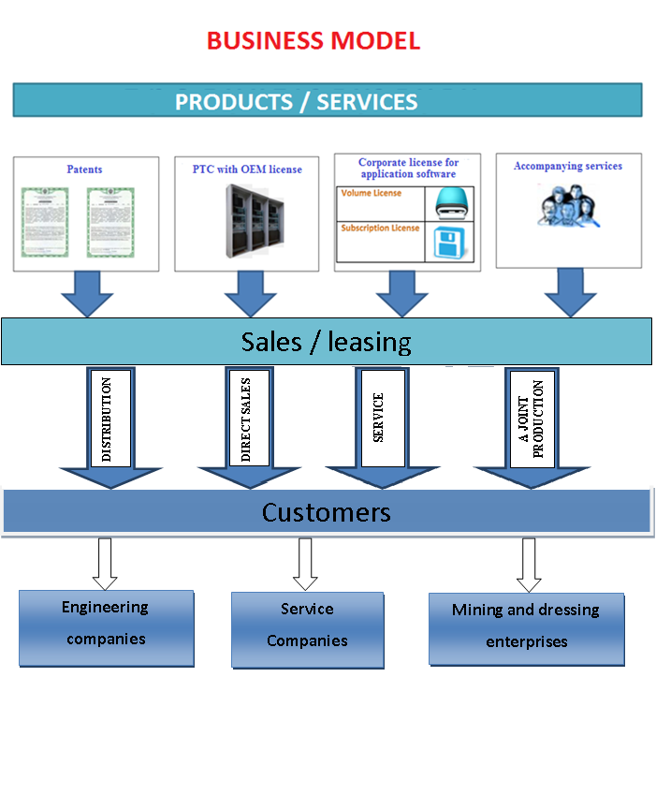
Automated on-line monitoring system of incoming ore flows for mining and processing plants
Technology commercialization strategy. Business model

Slide 19
Automated on-line monitoring system of incoming ore flows for mining and processing plants
Specification of methodological and scientific-technical solutions for the creation of the OMIOQ "Timed Interval Calculus" Technology
Rules for the TIC-model of belonging the ore of the segment of output stream to a particular wagon of one of the input discrete streams, and hence the definition of ore belonging to a career
Rule 1. Binding events to the timeline. If S_{i}^{sv}=true then T_{i}^{sv} = t , where: S_{i}^{sv} – sign of the dump of the i-th wagon, T_{i}^{sv} - dump time of the i-th wagon, t – current time. This rule means that if an accident occurred in the wagon, the time for the wagon is equal to the current time.
Rule 2. Determination of the time interval for crushing ore in a bunker. If 〖 W_{i}^{oj} – P^{bunk} ≠ 0〗 ={x,y: T | ∀t : [x…y] ∗(W_{i}(α([x…y])) = W_{i}^{oj} ⋀ W_{i}(ω ([x…y]))=0 ⋀ W_{i}= W_{i}- P^{bunk})} then t^{bunk}= σ([x…y]), where: W_{i}^{oj} – estimated weight of the ore of the i-th wagon; P^{bunk} - Hopper capacity per second; W_{i} – Current weight of the ore of the i-th wagon, t^{bunk} - The time interval for crushing the ore of the bunker. This rule means that in each cycle (1 second) of the total weight of the ore in the bunker, the quantity equal to the productivity of the hopper per second is subtracted. This rule allows you to calculate the time spent by the bunker on crushing the dumped car and fix the expected moment of the end of the wagon exit from the bunker..
Rule 3. Determination of the time interval from the moment of appearance of the ore of the wagon on the conveyor until the moment of measurement on the conveyor scales. t_{i}^{konv}=L^{konv}/V^{konv}, where L^{konv} – Conveyor length to conveyor weights; V^{konv} – Conveyor speed.
Rule 4. Determination of the expected time of the beginning of the flow of ore in the wagon through the balance.. T_{i}^{ojnach} = T_{i}^{sv} + t^{bunk} + t_{i}^{konv}. This rule means that the expected time for the beginning of the flow of ore in the wagon through the scale is determined by the sum of the time of the dump of the wagon with the time interval for crushing the ore of the hopper and the time interval when the appearance of the ore of the wagon on the conveyor.

Slide 20
Automated on-line monitoring system of incoming ore flows for mining and processing plants
Specification of methodological and scientific-technical solutions for the creation of the OMIOQ "Timed Interval Calculus" Technology. Continuation
Rules for the TIC-model of belonging the ore of the segment of output stream to a particular wagon of one of the input discrete streams, and hence the definition of ore belonging to a career
Rule 5. Calculation of the length of the time interval of the wagon's flow. If 〖S_{i}^{sv}=true & t ≥ T_{i}^{ojnach}〗 = {x,y : T | ∀t : [x…y] ∗( S_{i}^{sv}=true ⋀ t ≥ T_{i}^{ojnach})} then { W_{i}∑=0; while (W_{i}∑ ≤ W_{i}^{oj}) W_{i}∑ = W_{i}∑ + W_{i}; t=t+1; end {T_{i}^{int} = t - T_{i}^{ojnach}; T_{i}^{ojkon} = T_{i}^{ojnach} + T_{i}^{int}}} This rule means that if the wagon wreck event occurred and the current time is greater than or equal to the time of the expected start of the wagon unloading, then the condition is checked whether the total weight of the wagon wagon is less than the expected weight of the wagon and, as soon as this condition is not fulfilled, calculated the interval of ore flow of wagon and time of the end of the wagon flow.
Rule 6. Correction rule of the time beginning of the flow of the wagon. If 〖W(t)-W(α)≥0,05W(α)〗={ x,y : T | ∀t : [x…y] ∗ (W(t)-W(α([x…y]))) ≥0,05 W(α([x…y]))⋀σ[x…y]≥5} then t_{i}^{nachpot}=α([x…y]). This rule means that as the start time of the flow, the system captures a significant (more than 5 seconds) and stable (more than 5%) increase in the signal from the weight sensor.
Rule 7. The rule for adjusting the end time of the wagon's flow. If 〖W(t)-W(α) ≤0,03W(α)〗={ x,y : T | ∀t : [x…y] ∗ (W(t)-W(α([x…y]))) ≤ 0,03W(α([x…y])) ⋀ σ[x…y]≥5} then t_{i}^{konpot} = w([x…y]). This rule means that as the end-of-flow time the system fixes a stable (more than 5 seconds), close to zero (not more than 3%) value of the signal from the weight sensor.

Slide 21
Automated on-line monitoring system of incoming ore flows for mining and processing plants
Specification of methodological and scientific-technical solutions for the creation of the OMIOQ
The main refinements of the technique of operational diagnostics of input ore flow characteristics
1. Refinement of the calibration procedure for the measuring channels for the AS OMIOQ The need for refinement. Methodical solutions for calibration of measuring channels are predetermined by the need to take into account changes in the metrological characteristics of instruments used in the AS OMKVR due to their mechanical wear or changes in the electromagnetic environment in the measurement zone. In the basic functional specifications of the AS OMIOQ, the channel calibration service is not taken into account.
2. Solutions for adjusting the parameters of the mathematical model of monitoring in the AS OMIOQ The need for refinement. In the basic functional specifications of the OMIOQ, the inevitable changes in the parameters of objects and monitoring processes during operation were not taken into account, which requires periodic adjustment of the characteristics of the instruments and adaptation of the model parameters as the residuals arise between the model and real indicators. The mathematical model forms the basis for the procedure for projecting the dynamics and chronology of unloading wagons into a bunker to segments of ore flow after a major crushing operation. Inaccuracies in the parameters of the model will reduce the objectivity of the results obtained.

Slide 22
Automated on-line monitoring system of incoming ore flows for mining and processing plants
Specification of methodological and scientific-technical solutions for the creation of the OMQO
Adjusting model parameters
For a standard train, for each wagon before unloading, the following was determined in the hopper: the weight of the ore, the content of the useful component, the mine and the like
Reference train
Reference data
Monitoring data
Adjustment of the parameters of the analytical block of AS OMIOQ
based on the use of a simulation model of processes at monitoring objects
AS OMQO
Analytical unit of the AS OMVKR
Adjusted parameters of the analytical block

Slide 23
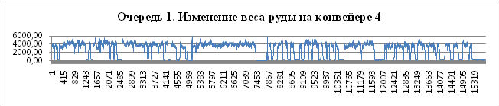
Automated on-line monitoring system of incoming ore flows for mining and processing plants
Specification of methodological and scientific-technical solutions for the creation of the OMIOQ Calibration of measuring instruments
t1
t2
W
t2
ti
t1
Lack of ore flow on the conveyor
t
Calibration of measuring devices is carried out in the absence of ore on a moving conveyor.(In this example, on the intervals t1, t2, ti).
For zero is the value (Wt1+Wt2+……+ Wti)/ (t1+t2+…+ti)

Slide 24
Automated on-line monitoring system of incoming ore flows for mining and processing plants
Justification of the choice of analyzers
Parameters | Instruments with X-ray tube | Radioisotope | Laser | Neutron | Optical
Analyzed elements | From Al to U | From Mg to U | From C to U | From C to U | From H to Mt
Value Range Ambient temperature Air, oC | -20 to +45 | -30 to +50 | -20 to +45 | -30 to +50
Dimensions, mm | 890x275x240 | Sensor 150х140х300 Power cabinet 300х250х170 | 1500x800x1300 | 2103х1690х1575 | Lighting unit 2000x2000x1000 Cabinet with electronics 1300х800х200
Weight, kg | 45 | Sensor 5 Power cabinet 6,5 | 450 | from 2721 to 4081 | 180
Area / volume of analysis | Surface | Scope | Surface | Scope | Surface
Limits of detection and accuracy | For all stream analyzers - up to 100ppm (0.01%), vary depending on the elements
Danger to health Of staff | there is | Unlikely | no | there is | no
Frequency of analysis, samples / min | Continuously | Continuously | 3-20 | 1, Possibly continuously | 20

Slide 25

Automated on-line monitoring system of incoming ore flows for mining and processing plants
Project technical support. Structural diagram of the Hardware Complex

Slide 26
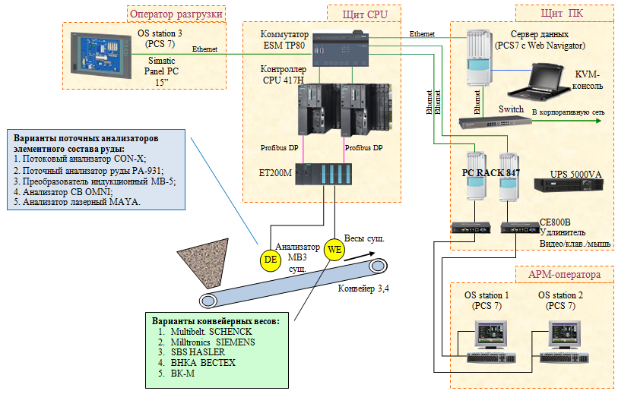
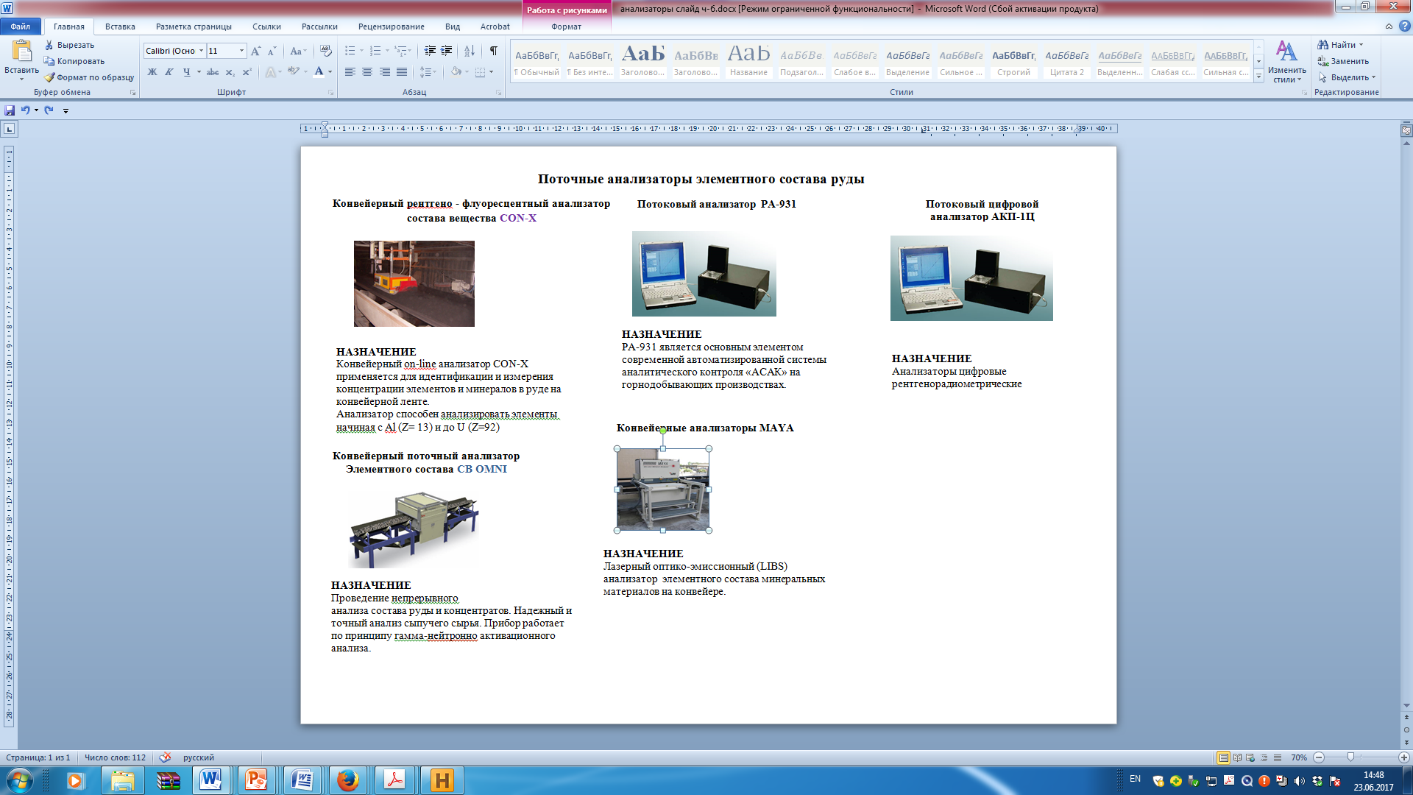
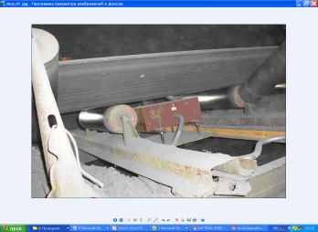
Automated on-line monitoring system of incoming ore flows for mining and processing plants
Technical support project. Instrumentation
Индукционный конвейерный анализатор МВ-5
Конвейерный анализатор наличия Fe в потоке
Notes:
РИСУНОК 2

Slide 27
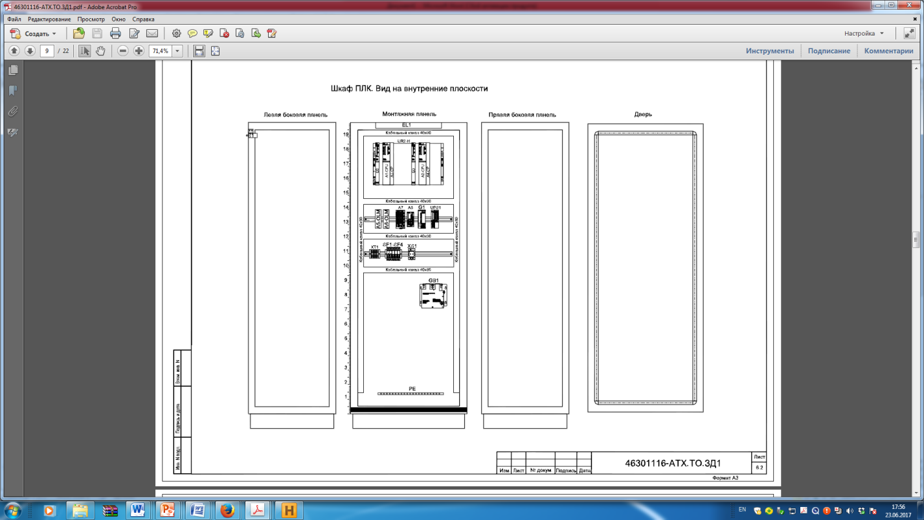
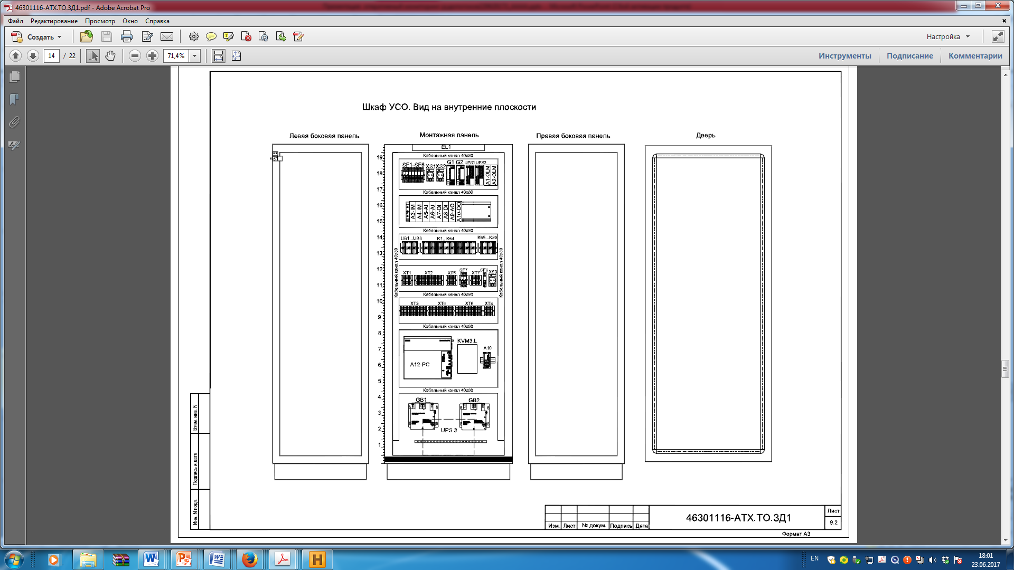
Automated on-line monitoring system of incoming ore flows for mining and processing plants
Technical support project. Cabinets (General drawing)

Slide 28
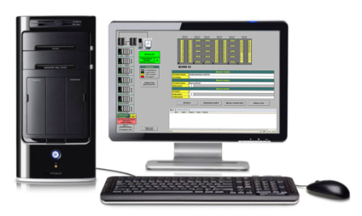
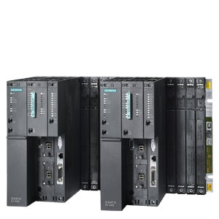
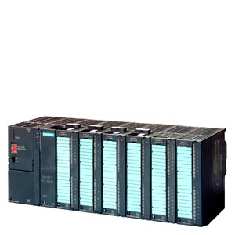
Automated on-line monitoring system of incoming ore flows for mining and processing plants
Information Support. Data collection scheme for analysis
АРМ
Unloading control
On request
PLC
Data on ore flows
After crushing
Once every 10 seconds
DATABASE
Situational information
by unloading zone
By event
Chronology of unloading
Once a second

Slide 29
Automated on-line monitoring system of incoming ore flows for mining and processing plants
Information Support. Logical diagram of the database of the controller station
DB_ПУТЬ
DB_ВЕРТУШКА
DB_СВАЛ
Номер пути
Номер склада
Номер вертушки
Номер склада
Номер вертушки
Номер вагона
DB_СВОДКА
DB_СКЛАД
DB_ВАГОН
Номер вагона
Номер вертушки
Номер склада
Номер пути
Номер склада
Скорость дробления
Номер вертушки
Номер вагона
DB_БУНКЕР
DB_ВЕСЫ
Номер вагона
Номер вагона
ВЕС

Slide 30
Automated on-line monitoring system of incoming ore flows for mining and processing plants
Information Support. Functionality DB of the controller station
DB numbers | Characteristics of ore flow / Situational information | Fixing / calculation frequency | Duration of storage | Note
DB51 – DB58 | Instantaneous weight and quality value from sensors on the conveyor | 1 second | two shifts | One DB for each indicator of each queue
DB140 – DB141, DB146 – DB149 | Moments of the input / output of the turntable for unloading, moments of movement / shutdown of the turntable, moments of the wagon | 1 second | two shifts | One DB for each indicator
DB301 – DB1091 | Weighted average weight and quality value for each wagon of the unloaded train | Every second calculation for the time of unloading the turntable | two shifts | The number of DBs is set on the basis of the maximum number of wagon trailers unloaded in two shifts
DB301 – DB1091 | Weighted average weight and quality value for each wagon of the unloaded train in one hopper | Every second calculation for the time of unloading the turntable | two shifts

Slide 31
Automated on-line monitoring system of incoming ore flows for mining and processing plants
Information Support. Linked lists of data blocks (DB)
Linked list
«Вертушки»
Linked list
«Вагоны очереди»
Linked list
«Вагоны вертушки»
DB3 Вертушка №1
DB3 Вагон №1
DB3 Вагон №1
№ DB предыдущей вертушки = 0
№ DB след-го вагона =5 № DB пред-го вагона =0
№ DB след-го вагона вертушки=5
DB5 Вертушка №2
DB5 Вагон №2
DB4 Вагон №1
№ DB предыдущей вертушки = 3
№ DB след-го вагона =6 № DB пред-го вагона =3
№ DB след-го вагона вертушки=7
DB6 Вертушка №3
DB6 Вагон №3
DB7 Вагон №1
№ DB предыдущей вертушки = 5
№ DB след-го вагона ={K} № DB пред-го вагона =5
№ DB след-го вагона вертушки={K}
…………………………...........
…………………………...........
…………………………..........
DB{N} Вертушка №S
DB{N} Вагон №S
DB{N} Вагон №{S}
№ DB предыдущей вертушки = {k}
№ DB след-го вагона ={M} № DB пред-го вагона ={J}
№ DB след-го вагона вертушки={M}
DB{M} Вертушка №S+1
DB{M} Вагон №S+1
DB{M} Вагон №S+1
№ DB предыдущей вертушки = {N}
№ DB след-го вагона =0 № DB пред-го вагона ={N}
№ DB след-го вагона вертушки=0

Slide 32
Automated on-line monitoring system of incoming ore flows for mining and processing plants
Database table structure
DB «Путь»
1. № пути
2. № DB последней вошедшей вертушки
3. Момент Команды на ввод данных по вертушке
4. Момент Команды на объединение вертушек
5. Момент Команда на разделение вертушки
6. № вертушки (для команд)
7. № электровоза (для команд)
8. № склада (для команд)
9. Вес вертушки заявленный (для команд)
10. № вертушки для объединения
11. Количество вагонов в первой вертушке при разделении одной вертушки на две
DB «Бункер»
1. Емкость
2. Текущая масса
3. Коэфф. коррекции производительности
4. Производительность на выходе
5. DB первого вагона
6. DB последнего вагона
DB «Сводка»
1. Порядковый номер строки сводки
2. Время подачи вертушки на бункерный путь
3. Время выхода вертушки с бункерного пути
4. Номер электровоза
5. Номер склада, с которого загружена вертушка
6. Вес вертушки заявленный (введенный оператором ККД)
7. Вес вертушки, реально принятый на фабричный передел
8. Средне взвешенное содержание железа в руде вертушки
9. Количество выгруженных вагонов
10. Номер бункерного пути, на котором находится вертушка
DB «Склад»
1. Номер склада
2. Формула Коэффициент «А»
3. Формула Коэффициент «B»
4. Скорость прохождения руды через дробилку
DB «Вагон»
1. Тип (обмоторенный / обычный)
2. Заявленная масса
3. Содержание Fe
4. Время свала
5. Время начала выхода из бункера
6. Время конца выхода из бункера
7. Время начала прохода весов
8. Время конца прохода через весы
9. Ссылка DB вертушки
10. Номер вагона
11. Ссылка DB след. вагона вертушки
12. Ссылка DB след. сваленного вагона
13. Ссылка DB пред. сваленного вагона
DB «Весы»
1. Текущий вес без нуля
2. Текущий вес с учетом нуля
3. Ноль весов
4. Суммарный вес текущего потока
5. Ссылка DB текущего вагона
6. Время начала потока
7. Время конца потока
8. Флаг конца потока
9. Магнитная восприимчивость

Slide 33

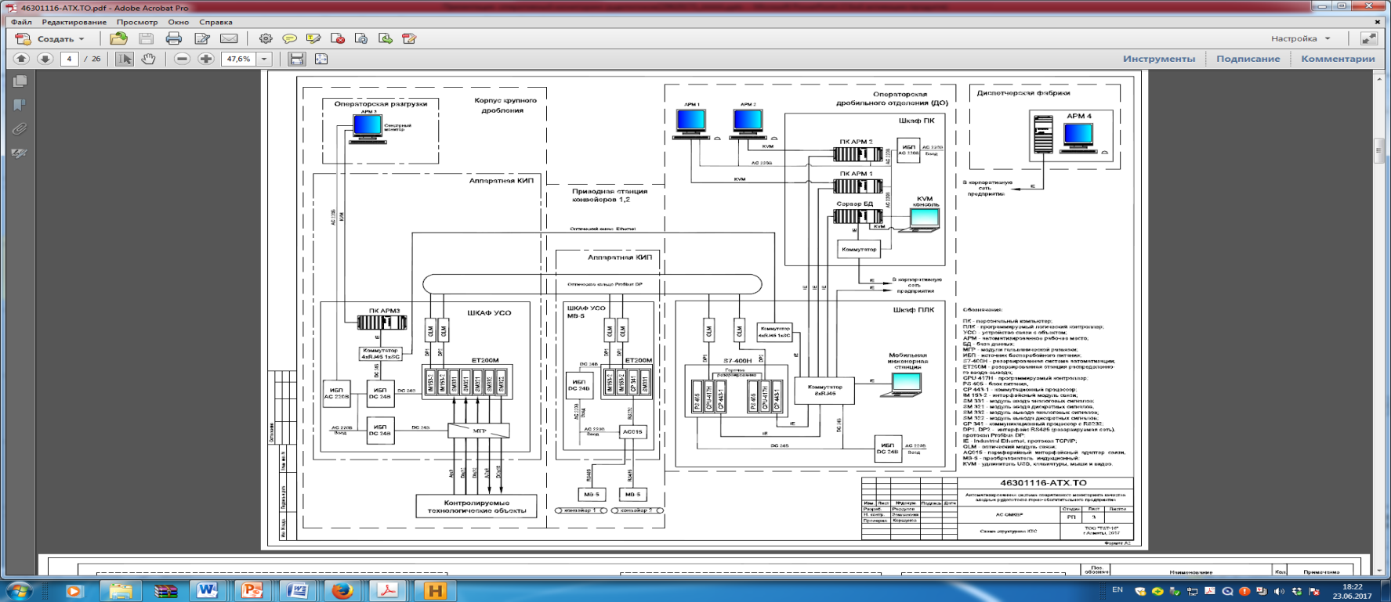

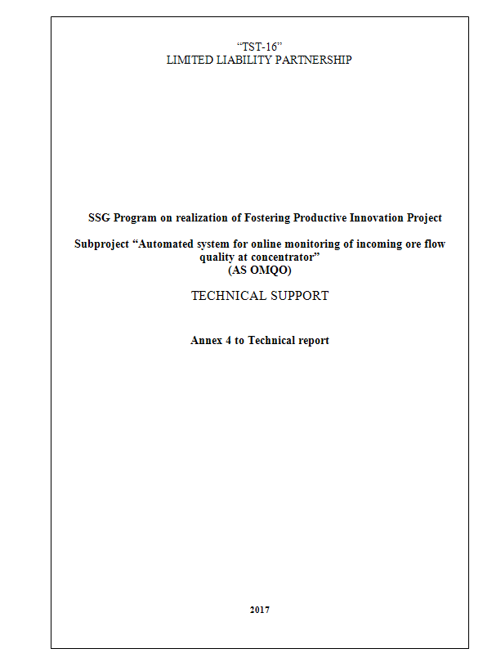
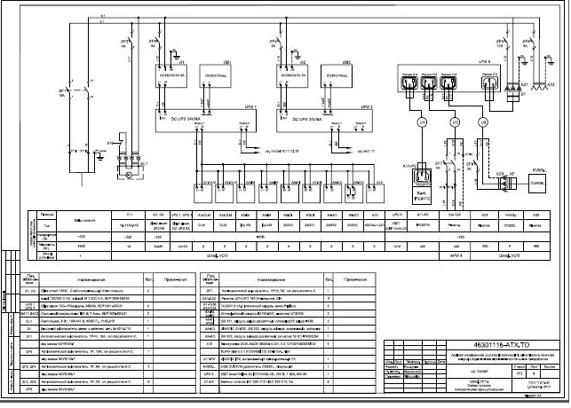
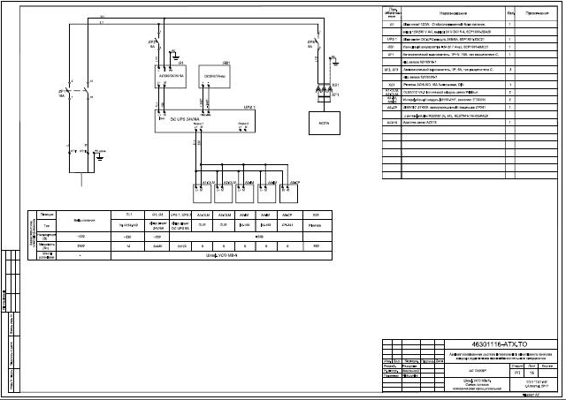
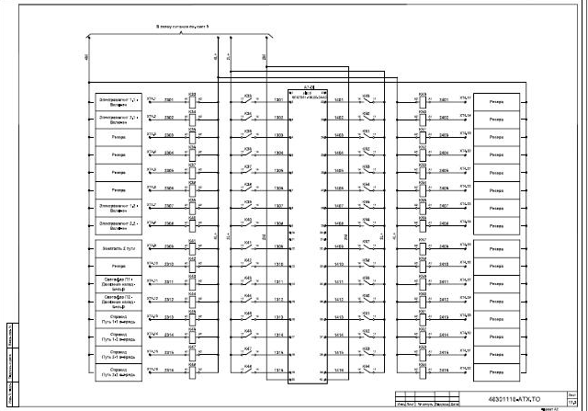
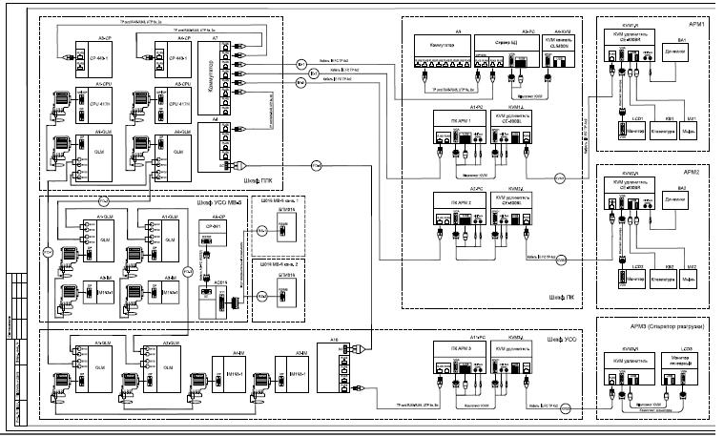
Automated on-line monitoring system of incoming ore flows for mining and processing plants
Technical support
Лист | Наименование | Примечание
1 | Ведомость документов проекта | Разработана в 1-ом полугодии
2 | Общие данные
3 | Схема структурная КТС | Разработана в 1-ом полугодии
4 | Схема интерфейсных соединений | Разработана в 1-ом полугодии
5 | Шкаф ПК. Схема питания электрическая принципиальная | Разработана в 1-ом полугодии
6 | Шкаф ПК. Схема подключения внешних проводок | Разработана в 1-ом полугодии
7 | Шкаф ПЛК Схема питания электрическая принципиальная | Разработана в 1-ом полугодии
8 | Шкаф ПЛК. Схема подключения внешних проводок | Разработана в 1-ом полугодии
9 | Шкаф УСО. Схема питания электрическая принципиальная | Разработана во 2-ом полугодии
10 | Шкаф УСО. Ввод аналоговых сигналов | Разработана во 2-ом полугодии
 | Схема электрическая принципиальная
11.1-11.3 | Шкаф УСО. Ввод дискретных сигналов | Разработана во 2-ом полугодии
 | Схема электрическая принципиальная
12 | Шкаф УСО. Вывод аналоговых сигналов | Разработана во 2-ом полугодии
 | Схема электрическая принципиальная
13 | Шкаф УСО. Вывод дискретных сигналов | Разработана во 2-ом полугодии
 | Схема электрическая принципиальная
14 | Шкаф УСО. Схема подключения внешних проводок | Разработана во 2-ом полугодии
15 | Шкаф УСО МВ-5. Схема питания электрическая принципиальная | Разработана во 2-ом полугодии
16 | Шкаф УСО МВ-5. Вывод аналоговых сигналов | Разработана во 2-ом полугодии
17 | Шкаф УСО МВ-5. Схема подключения внешних проводок | Разработана во 2-ом полугодии
18 | Схема соединения внешних проводок | Разработана во 2-ом полугодии
19 | Схема прокладки оптических кабелей Profibus | Разработана во 2-ом полугодии
20.1-20.4 | Кабельный журнал | Разработана во 2-ом полугодии

Slide 34



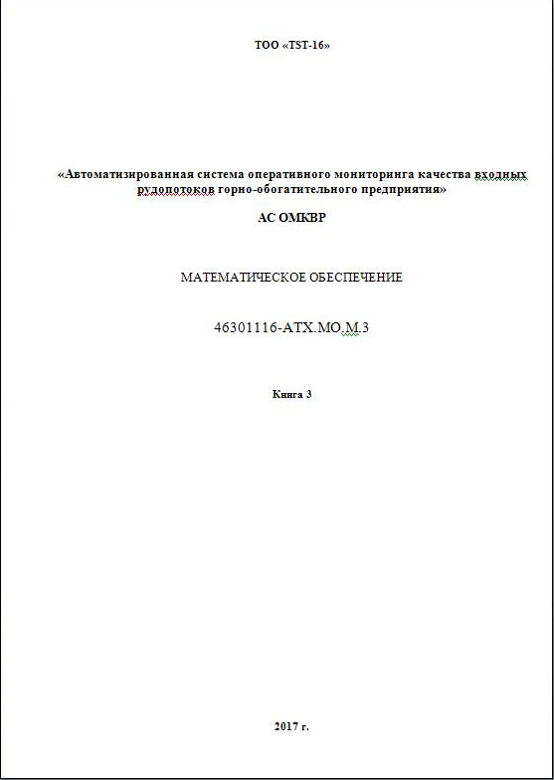
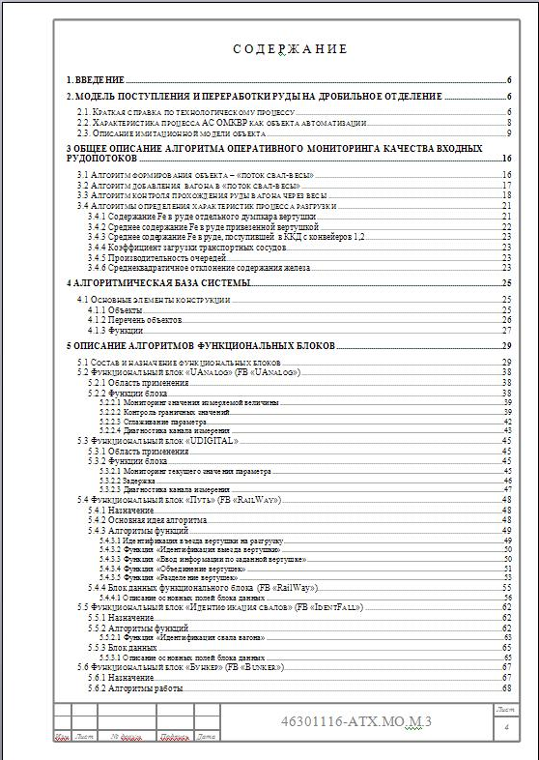
Automated on-line monitoring system of incoming ore flows for mining and processing plants
Mathematical support

Slide 35
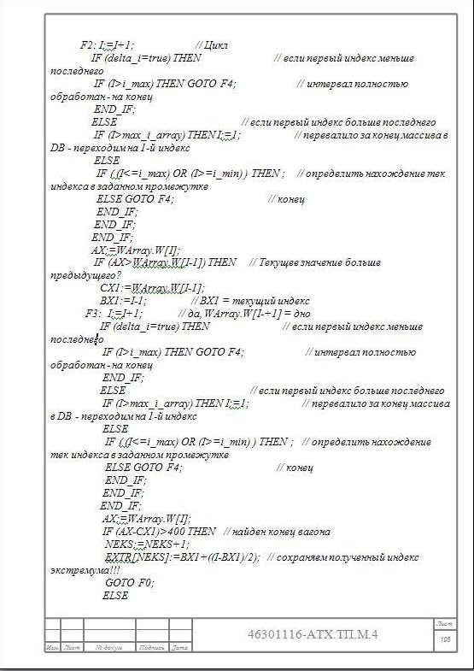
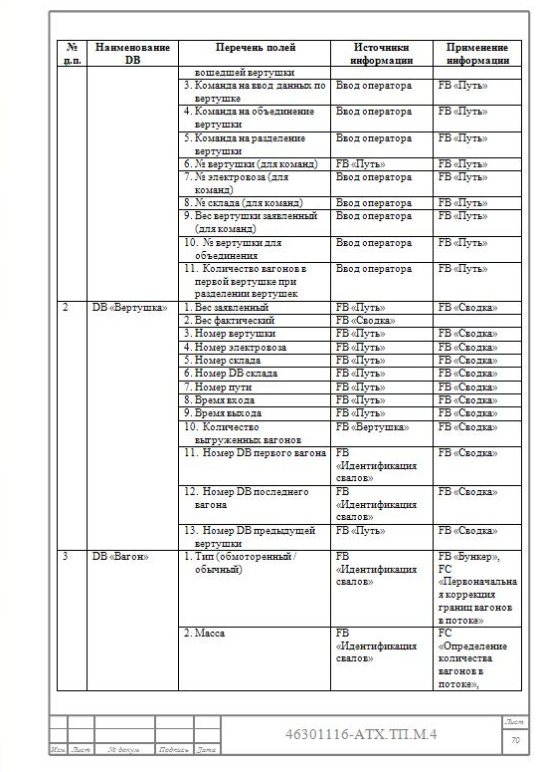
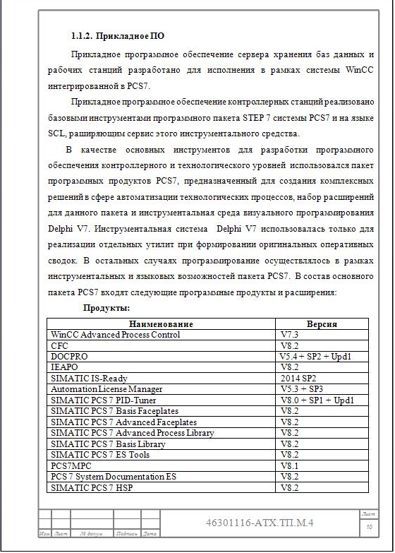
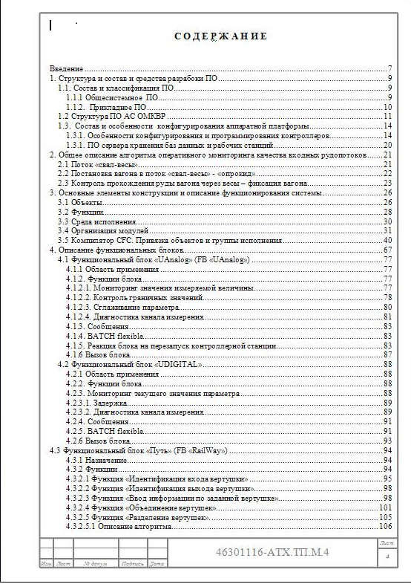
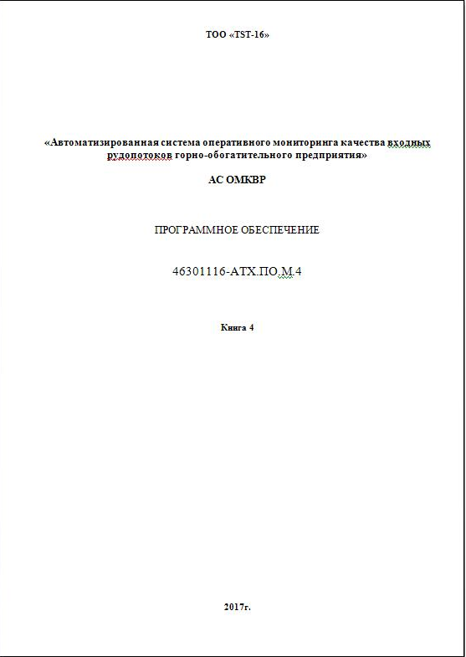

Automated on-line monitoring system of incoming ore flows for mining and processing plants
Application software

Slide 36
Automated on-line monitoring system of incoming ore flows for mining and processing plants
The main areas of work for the establishment of the OMVCS in the second half of 2017
First half of the year The work of the first half of 2017 was carried out in accordance with the subproject implementation plan
Second half of the year
The works of the second half of 2017 are planned for implementation in accordance with the subproject implementation plan and include:
Completion of design work for: maintenance; Mathematical support; Applied software of AS OMVKR.
Completion and installation of cabinet structures.
Completion of the system software platform.
Autonomous adjustment of control stations and workstations in polygon conditions of "TST-16" LLP.

Slide 37
Automated on-line monitoring system of incoming ore flows for mining and processing plants
Contact Information
Almaty city, 050000, Amangeldy str., 40/112, ТОО «TST-16»
Tel. 8-727-279-61-85, 8-701-406-0328
E-mail: gsns2016com.va@gmail.com
Limited Liability Company «TST-16»

