Slide 1
Senior Scientist Grant Program Manual
Project: Automated on-line monitoring system of incoming or flows for mining and processing plants
first half of 2018
Almaty 201

Slide 2
Automated on-line monitoring system of incoming ore flows for mining and processing plants
General information
Sub-project: Automated on-line monitoring system of incoming ore flows for mining and processing plants
Project Leader –U. Tukeyev
Grant recipient – «TST-16» LLP
Business partner – Systemotechnika LLP
Notes:
Рисунок 4

Slide 3
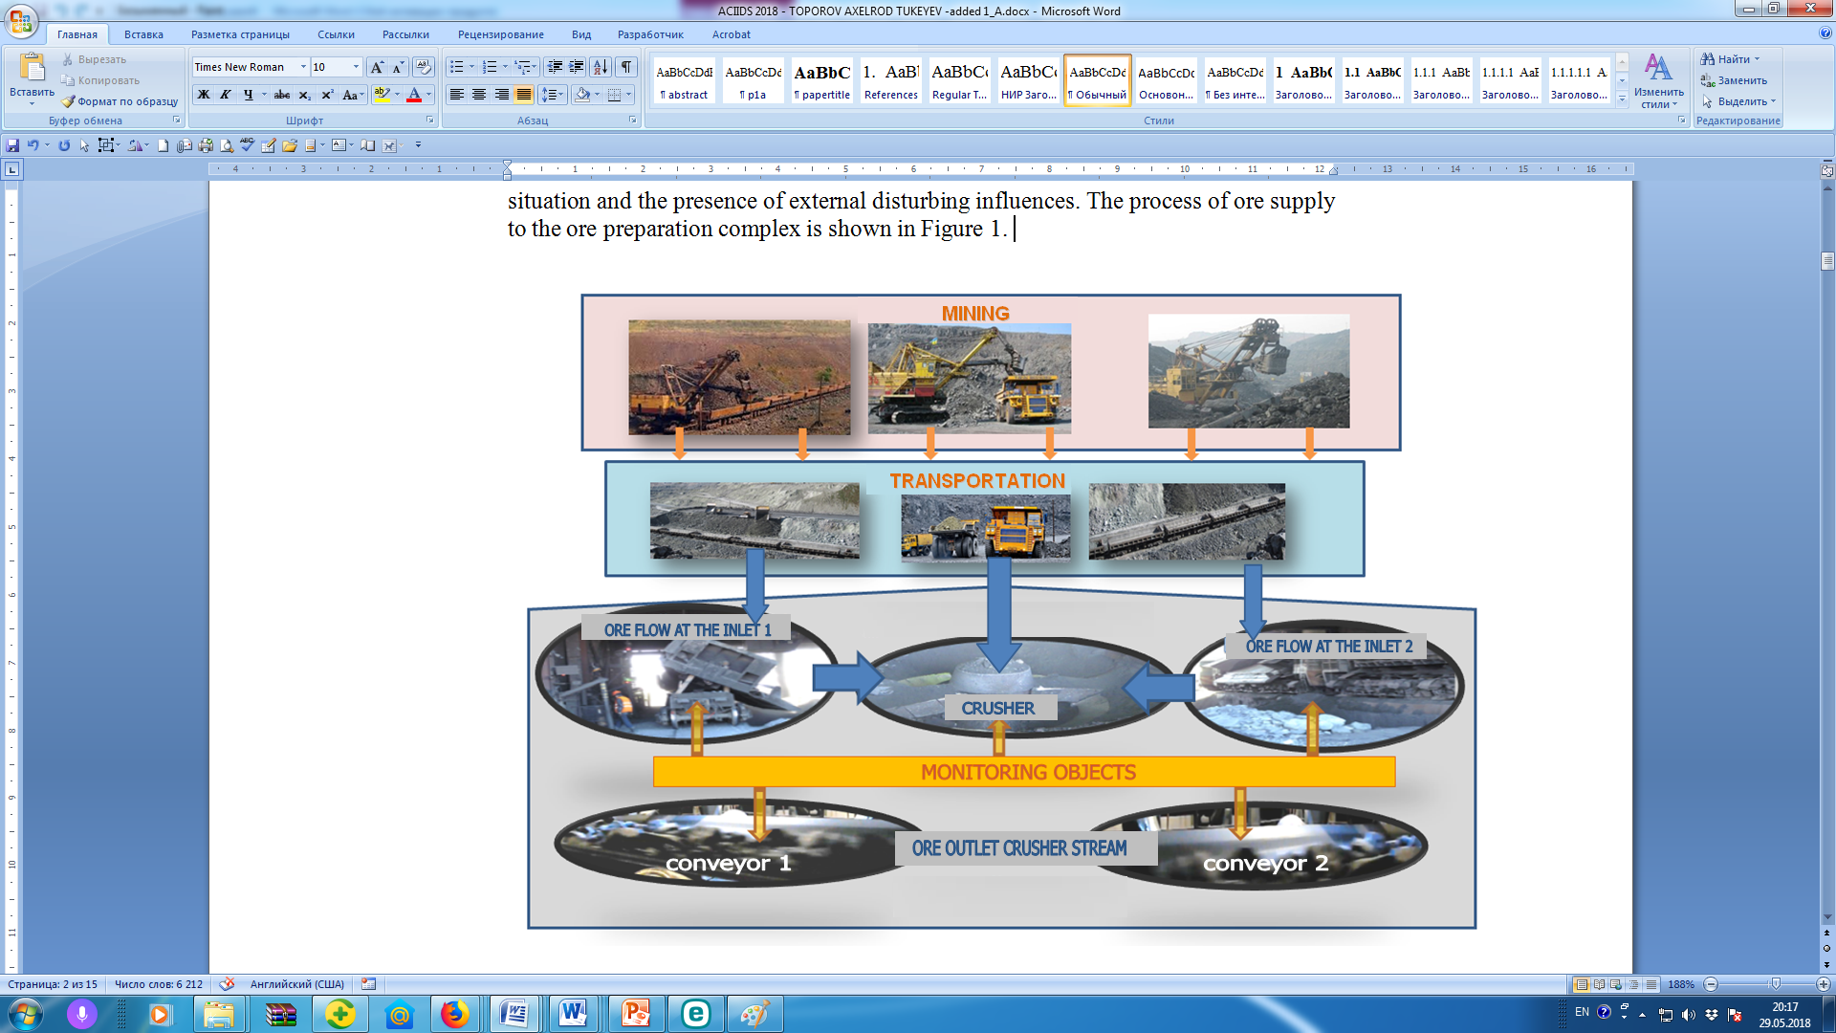
Automated on-line monitoring system of incoming ore flows for mining and processing plants
The process of ore supply to the ore preparation complex

Slide 4
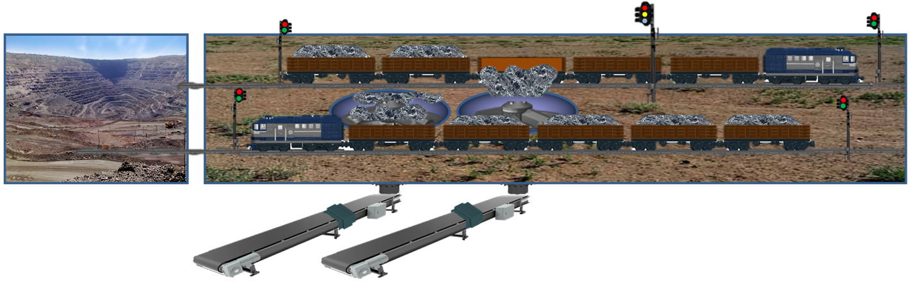
Automated on-line monitoring system of incoming ore flows for mining and processing plants
Structural scheme of information gathering and formation of the operational report of monitoring
Mine
Unloading area
Chronology ore carriers arriving at the factory
Chronology of movement in the unloading area
Analyzer
Scales
Quality control and dynamics of the ore flow after the LCP
Temporal pattern of movement in the unloading area
Analytics block: Disintegration of the flow of ore mixture after large crushing plant (LCP) on the basis of belonging to ore mines
Temporal pattern of work flow transport system
of the LCP
Summary results of the operational monitoring of the inlet ore flows of DP
The block of the account of quality and volume of ore accepted on LCP
Technological scheme of the monitoring object
Notes:
Рисунок 4

Slide 5

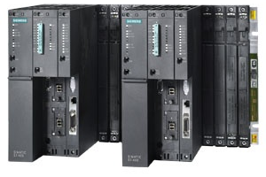
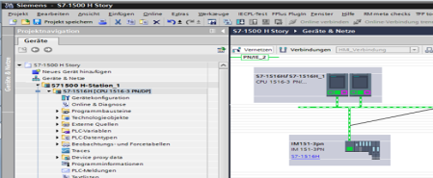

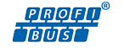
Автоматизированная система оперативного мониторинга качества входных рудопотоков горно-обогатительного производства
Features of the design of the base product
The level of functional
completeness
System of high degree of readiness for implementation
Base of the core of the hardware platform
Technologies for industrial automation TIA series S7
S7-417H Controller
Communication devices with object ET200M
Programming and service
Transparent programming
Simple porting (standard → H)
Typical engineering tools (all languages)
PCS7
Configuration
Extensive scalability
Scaling the redundancy architecture and switching time
Scaling performance of CPU 412 to 417
Communications
Standard Networking Technologies
Based on Profinet system backup
Profibus support is not planned
Notes:
Рисунок 4

Slide 6
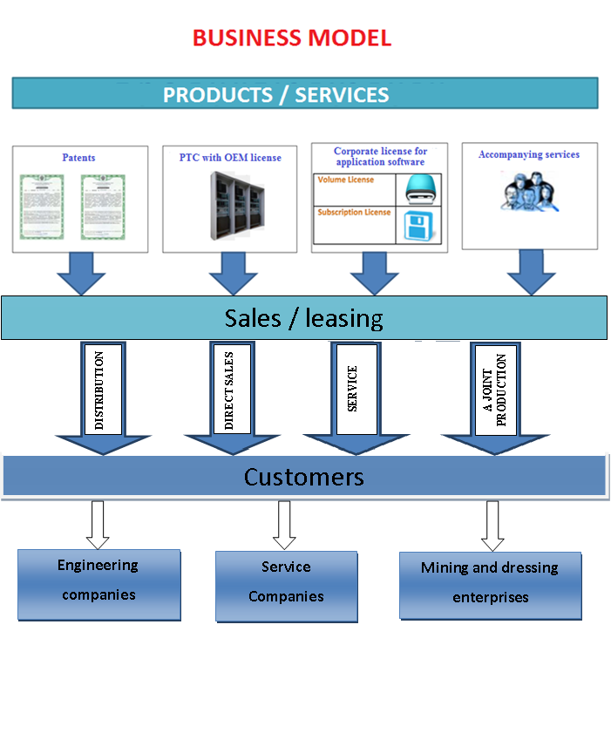
Automated on-line monitoring system of incoming ore flows for mining and processing plants
Technology commercialization strategy. Business model

Slide 7
Automated on-line monitoring system of incoming ore flows for mining and processing plants
Brief information on the current status of the implementation of the subproject
Beginning of the project January 2017 End of the project December 2018
The certificate for accreditation as a subject of scientific and scientific-technical activity of the MES of the Republic of Kazakhstan was received (Certificate No. 004985 series MC dated June 14, 2017)
Signed and registered with the National Institute of Intellectual Property of the Republic of Kazakhstan License agreement for the transfer of exclusive rights to use the invention "Automatic complex for monitoring the quality and quantity of ore flow in preparation for enrichment" under the patent No. 31642-TST-16 (License Agreement No. 01-2018030 / 12-21 from 24/01/2018 Licensor - Systemotechnica LLP, Licensee - LLP "TST-16")
The Certificate of state registration of rights to the object of copyright was obtained: "Automated system of operative monitoring of the quality of input ore-flows of the ore-dressing enterprise" (computer program). Certificate No. 2497 of 30.10. 2017g (Registered in the Ministry of Justice of the Republic of Kazakhstan on October 30, 2017 No. 2497)
The Certificate of state registration of rights to the subject of copyright was obtained: "Software simulator for testing and setting up systems for automated control of technological processes at the inlet of the ore preparation complex of the concentrating mill (Certificate No. 1230 of April 24, 2013, registered in the Ministry of Justice of the Republic of Kazakhstan on 24.04.2018 No. 1230)
An application for obtaining a patent of the Republic of Kazakhstan for an invention was filed (Registered in the RSE NIIS of the Ministry of Justice of the Republic of Kazakhstan on August 23, 2017, Reg. No. 2017 / 0705.1

Slide 8
Automated on-line monitoring system of incoming ore flows for mining and processing plants
Brief information on the current status of the implementation of the subproject (continuation)
The work on procurement and installation of a technical complex of the AS OMKVR at the testing polygon TST-16 was completed in accordance with the working documentation previously developed in the TST-16 (according to the procurement plan and work plan)
In this time are Tests AS OMKVR carried in order to ensure readiness for work at the industrial site of OJSC SSMPA. The work is planned to be carried out before the end of this year after the conclusion of the corresponding contract with SSMPA JSC
Specialists TST16 published report in the collection of the international conference ACIIDS 2018, Part II, LNAI 10752. Information about the collection is presented in the database of international scientific publications Scopus
An article on the subject of the subproject was sent to the journal: - "Journal of Information and Telecommunication" (commissioned by the organizing committee ACIIDS 2018).
A written confirmation was received from the SSGPO JSC on allocation of funds for the implementation of AS OMKVR in SSGPO's investment program for 2018 (Letter from the Director of the Department for Quality and Automation of Production dated 12.02.2018 Issue No. 01/1048)

Slide 9
Automated on-line monitoring system of incoming ore flows for mining and processing plants
Information on the violation of the planned terms of work for the subproject
№ | Planned works / activities | Current status | Delay
1. | Completion of assembly and installation of cabinets of basic sample of ore flow online monitoring system of concentrator. | Completed | no
2 | Completion of kitting of System Software Platform | Completed | no
3. | Completion of installation of basic software on workstations of technologists | Completed | no
4. | Binding of working documentation to ore preparation technological schemes of ODE of "SSGPO" JSC. | Completed | no
5. | Defining parameters of technical means of online input ore flow qualitymonitoring system of ODE "SSGPO" JSC. | Completed | no
6. | Adjustment of CCU controller cabinet of online input ore flow qualitymonitoring system ODE "SSGPO" JSC. | Completed | no
7. | Adjustment of cabinets of industrial PCs for online input ore flow qualitymonitoring system of ODE "SSGPO" JSC. | Completed | no
8. | Adjustment of controller cabinet of remote terminal unit with online input ore flow quality monitoring system of ODE "SSGPO" JSC. | Completed | no
9. | Adjustment of interfaces of command panel operator of online monitoring AS. | Completed | no
10. | Supply of AS OMIOQ hardware-software complex to ODE "SSGPO" JSC. | Completed 30% | no (completion of delivery according to the work plan is provided in the third quarter of 2018)

Slide 10















Automated on-line monitoring system of incoming ore flows for mining and processing plants
Integrated technology assessment for the 29/06/2018
Determining the viability of technology
Perception of value
Characteristics
Interview
Features
Customer Needs
Importance for the client (+3 & -3)
Benefits for customers
Technology (+3 & -3)
Competitors
Technical Expert
Monitoring of the quality of input ore flows to ore-processing plant in real time.
Reduce hardware monitoring costs
Operational management of the technological chain "mine-crushing-enrichment“
Domestic producer
Оперативный учет объема
и качества рудопотоков с
карьеров
Сокращает время определения качества руд из рудников
Производственный контроль и управления качеством готовой продукции
Улучшает координацию и повышает ритмичность работы технологических переделов ГОКа.
+3
+3
+2
+1
-1
-1
• TECHNOROS LLC
• Uraludoavtomatika
Salikhov Zufar Garifullovich. Doctor of Technical Sciences, Professor, Honored Scientist of Russia, Academician of RAIN and MANB, Chief Researcher of the Institute of Problems of Management of the Russian Academy of Sciences.
Competitive advantages
Technical readiness
Market
Problems
Solutions
Degree of technology readiness
Segments market
The technologies applied in practice are oriented to monitoring fine-fractional ore flows and to a single-flow scheme for their reception for processing.
The use of the proposed technology, which provides on-line monitoring of the incoming ore-bearing GOP in real time
This technology is in the process of practical testing after completion of design work. In this regard, a set of technical equipment was installed at the TST-16 test site. At present, the testing and preparation of the complex for approbation of technical solutions and equipment of the OMKVR in industrial conditions at a potential customer of the SSGPO technology have been completed. Together with SSGPO and Systemotechnika LLP, work is underway to conclude an appropriate agreement "before the end of 2018"
Extraction and processing of mineral raw materials
Manufacture of building materials
USERS
Innovative significance
Mining and dressing plants
Enterprises for the production of building materials
The proposed technical solutions complement the existing basic methods for controlling the characteristics of ores entering the processing, which makes it possible to improve the efficiency and accuracy of raw material estimates and the efficiency of its processing.
Risks and barriers
No approbation in industrial conditions
The emergence of direct competitors
Dependence on the financial condition of enterprises of the mining and processing complex
The status of intellectual property
Co-investors / partners
Received the right of TST-16 to the patent of the Republic of Kazakhstan No. 31642 (intellectual basis of technology). In this connection, a license agreement has been signed. An application for a patent for an invention was filed: "A system for rapid automatic control of the characteristics of the ore stream in preparation for enrichment" (Patent for the new modern development of technology). The right to copyright objects was registered - application software for AS OMKVR (two certificates)
Systemotechnika LLP Co-investor of the project (co-financing 5,000,000 KZT) Providing scientific and patent database of the project
JSC SSGPO: provision of a site for industrial testing of the results of the subproject
Partners
Systemotechnika LLP
Notes:
ПО МАТЕРИАЛАМ TECHIN2B

Slide 11
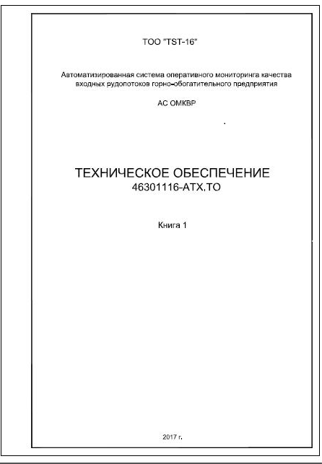




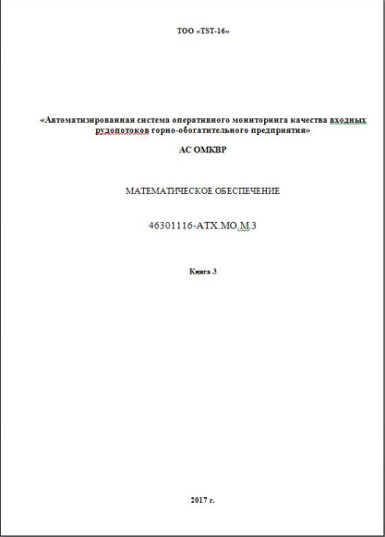
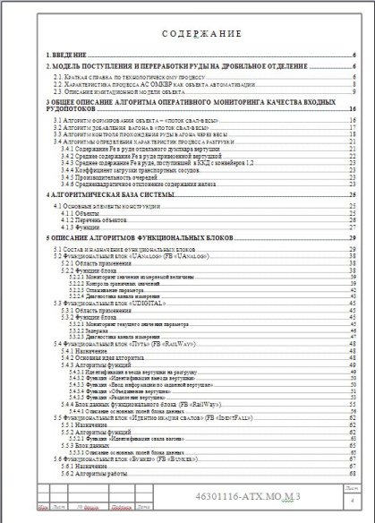
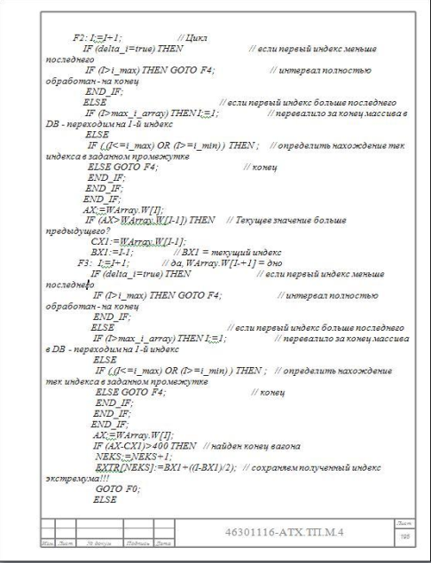
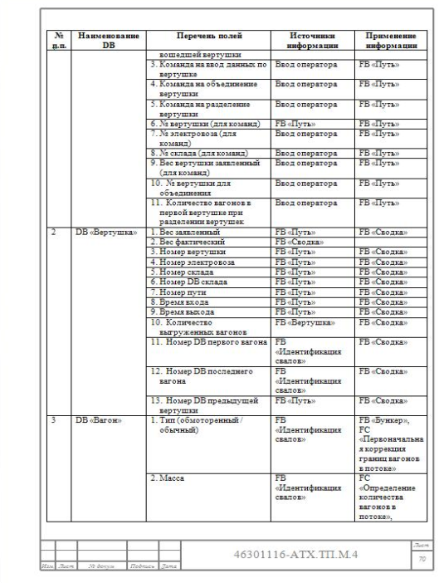
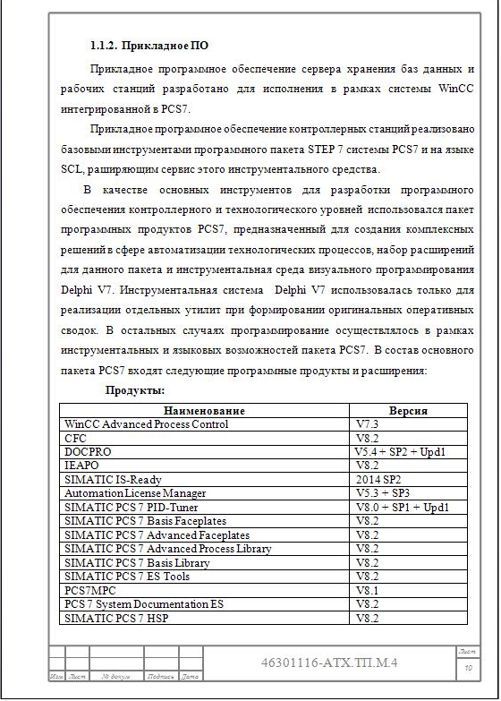
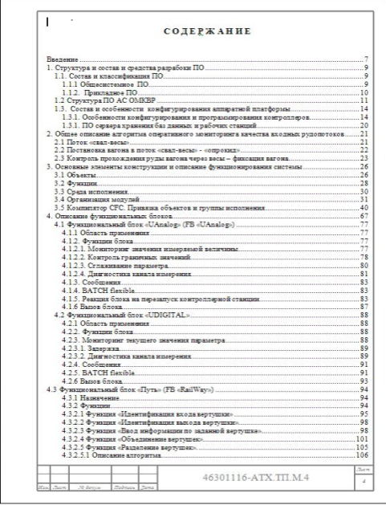
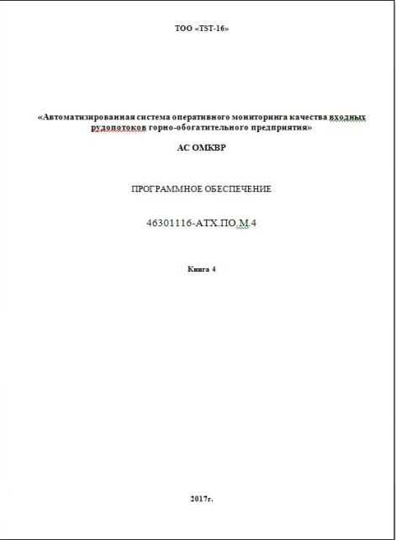

Automated on-line monitoring system of incoming ore flows for mining and processing plants
Working documentation for the monitoring system
Лист | Наименование | Примечание
1 | Ведомость документов проекта | Разработана в 1-ом полугодии
2 | Общие данные
3 | Схема структурная КТС | Разработана в 1-ом полугодии
4 | Схема интерфейсных соединений | Разработана в 1-ом полугодии
5 | Шкаф ПК. Схема питания электрическая принципиальная | Разработана в 1-ом полугодии
6 | Шкаф ПК. Схема подключения внешних проводок | Разработана в 1-ом полугодии
7 | Шкаф ПЛК Схема питания электрическая принципиальная | Разработана в 1-ом полугодии
8 | Шкаф ПЛК. Схема подключения внешних проводок | Разработана в 1-ом полугодии
9 | Шкаф УСО. Схема питания электрическая принципиальная | Разработана во 2-ом полугодии
10 | Шкаф УСО. Ввод аналоговых сигналов | Разработана во 2-ом полугодии
 | Схема электрическая принципиальная
11.1-11.3 | Шкаф УСО. Ввод дискретных сигналов | Разработана во 2-ом полугодии
 | Схема электрическая принципиальная
12 | Шкаф УСО. Вывод аналоговых сигналов | Разработана во 2-ом полугодии
 | Схема электрическая принципиальная
13 | Шкаф УСО. Вывод дискретных сигналов | Разработана во 2-ом полугодии
 | Схема электрическая принципиальная
14 | Шкаф УСО. Схема подключения внешних проводок | Разработана во 2-ом полугодии
15 | Шкаф УСО МВ-5. Схема питания электрическая принципиальная | Разработана во 2-ом полугодии
16 | Шкаф УСО МВ-5. Вывод аналоговых сигналов | Разработана во 2-ом полугодии
17 | Шкаф УСО МВ-5. Схема подключения внешних проводок | Разработана во 2-ом полугодии
18 | Схема соединения внешних проводок | Разработана во 2-ом полугодии
19 | Схема прокладки оптических кабелей Profibus | Разработана во 2-ом полугодии
20.1-20.4 | Кабельный журнал | Разработана во 2-ом полугодии

Slide 12
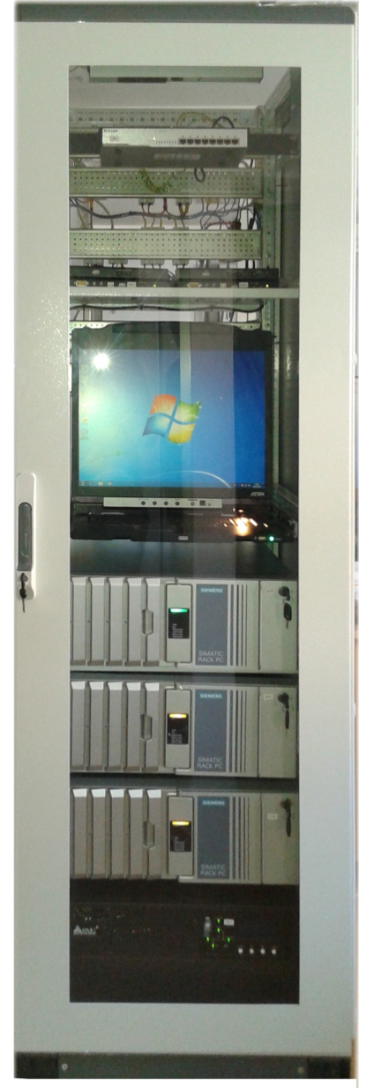
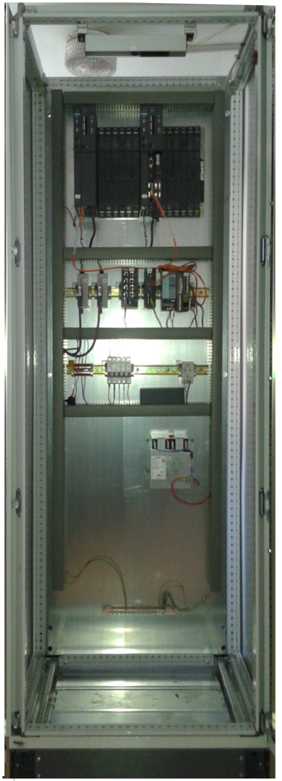
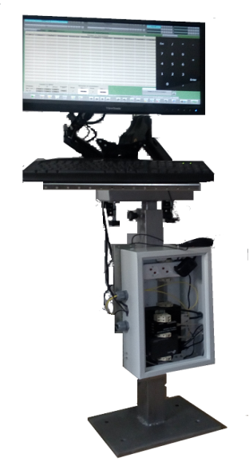
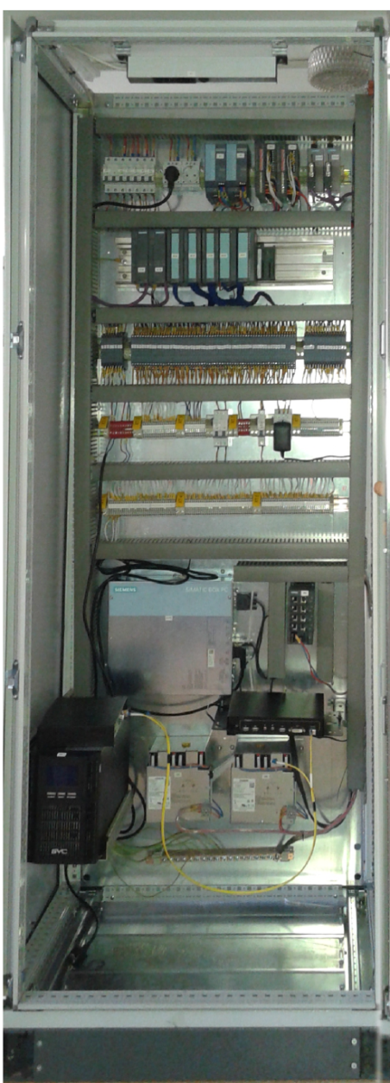
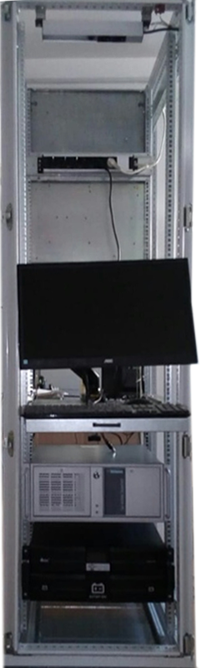
Automated on-line monitoring system of incoming ore flows for mining and processing plants
Boards and panels of automation of monitoring system (as of 29/06/2018)
PC cabinet
PLC CABINET
Command panel
CDO1 CABINET
STEND FOR SYSTEM SETUP
CDO2 CABINET

Slide 13
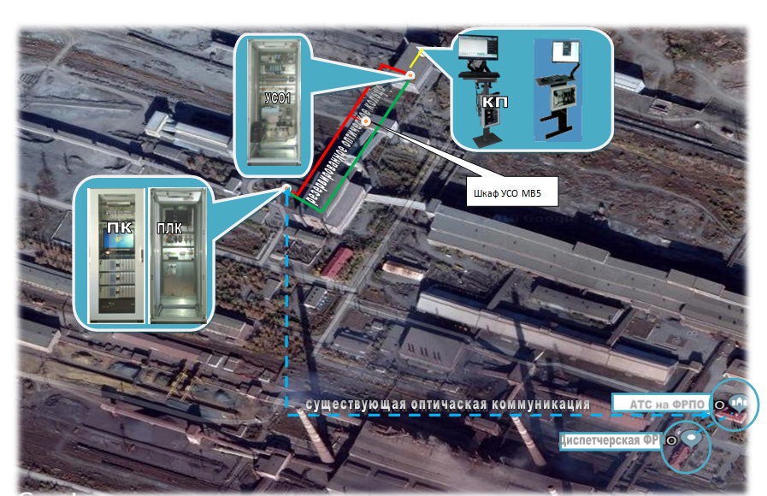
Automated on-line monitoring system of incoming ore flows for mining and processing plants
Topology of technical facilities for monitoring system at the mining and processing plant
(on the example of SSGPO JST as of 29/06/2018)
CDO1
CP
redundant optical ring
CDO2
PC
PLC
existing optical communication

Slide 14

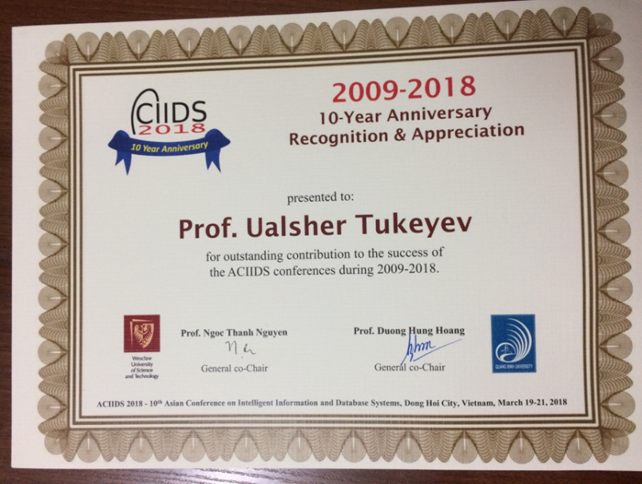
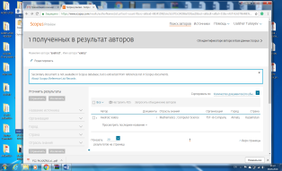
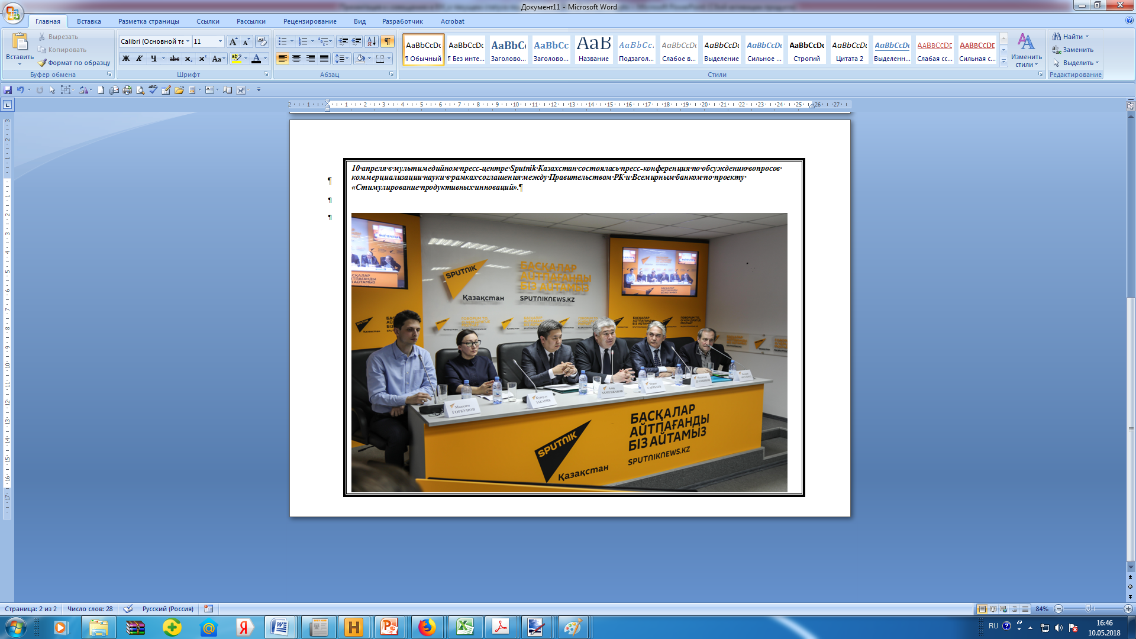
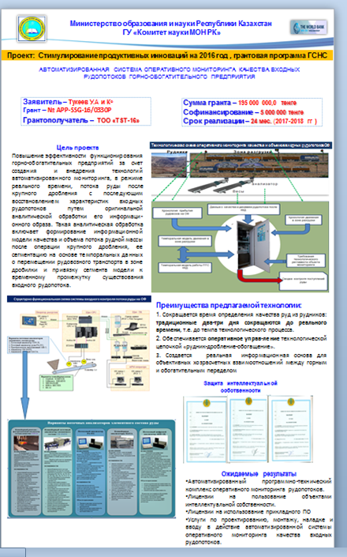
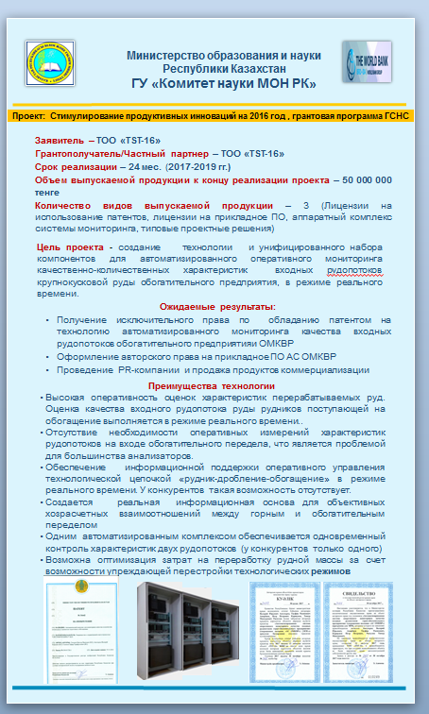
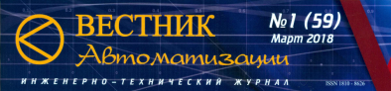
Automated on-line monitoring system of incoming ore flows for mining and processing plants
Advertising and information events (Publications and exhibitions with materials on the system)
Статья в журнал:
"Journal of Information and Telecommunication«
В печати. 28 .05.2018
В печати. Статья в Инженерно-технический Журнал : "Вестник Автоматизации" зарегистрирован МКиИ РК, Свидетельство №10134-Ж от 15.05.2009

Slide 15
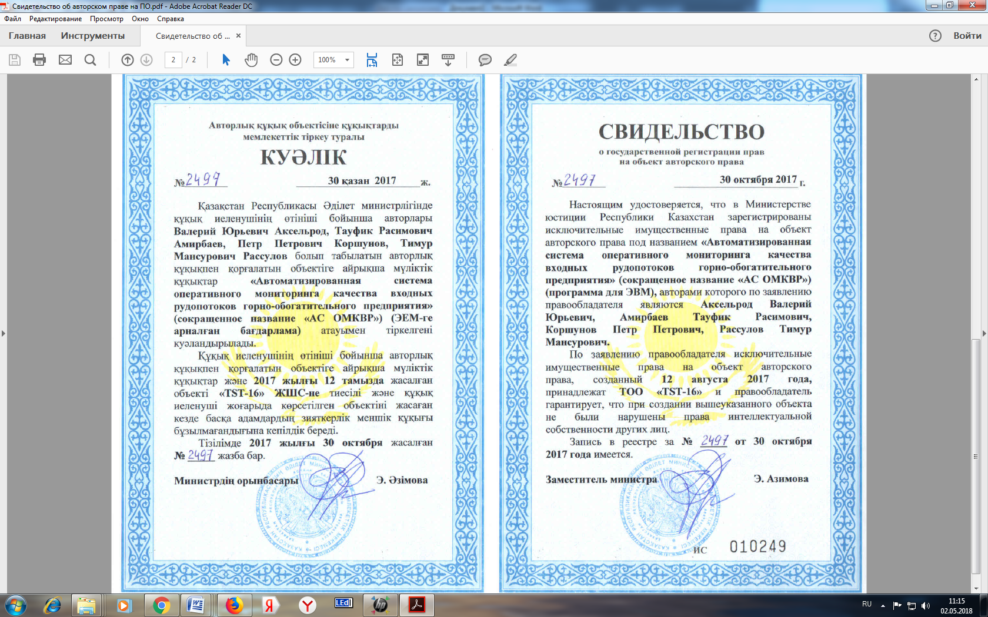
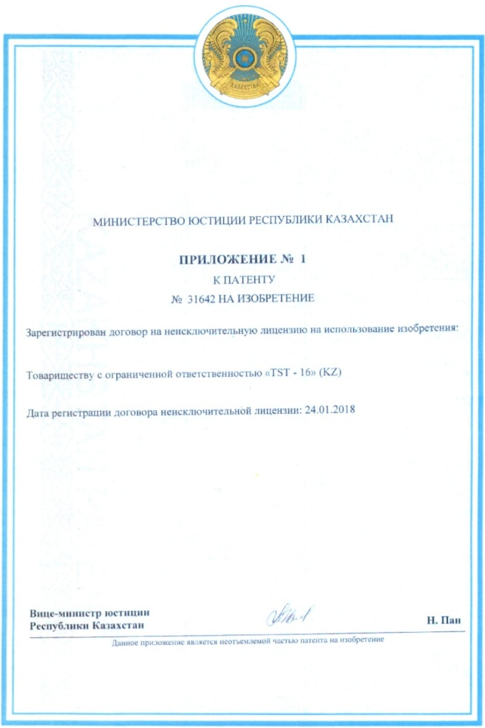
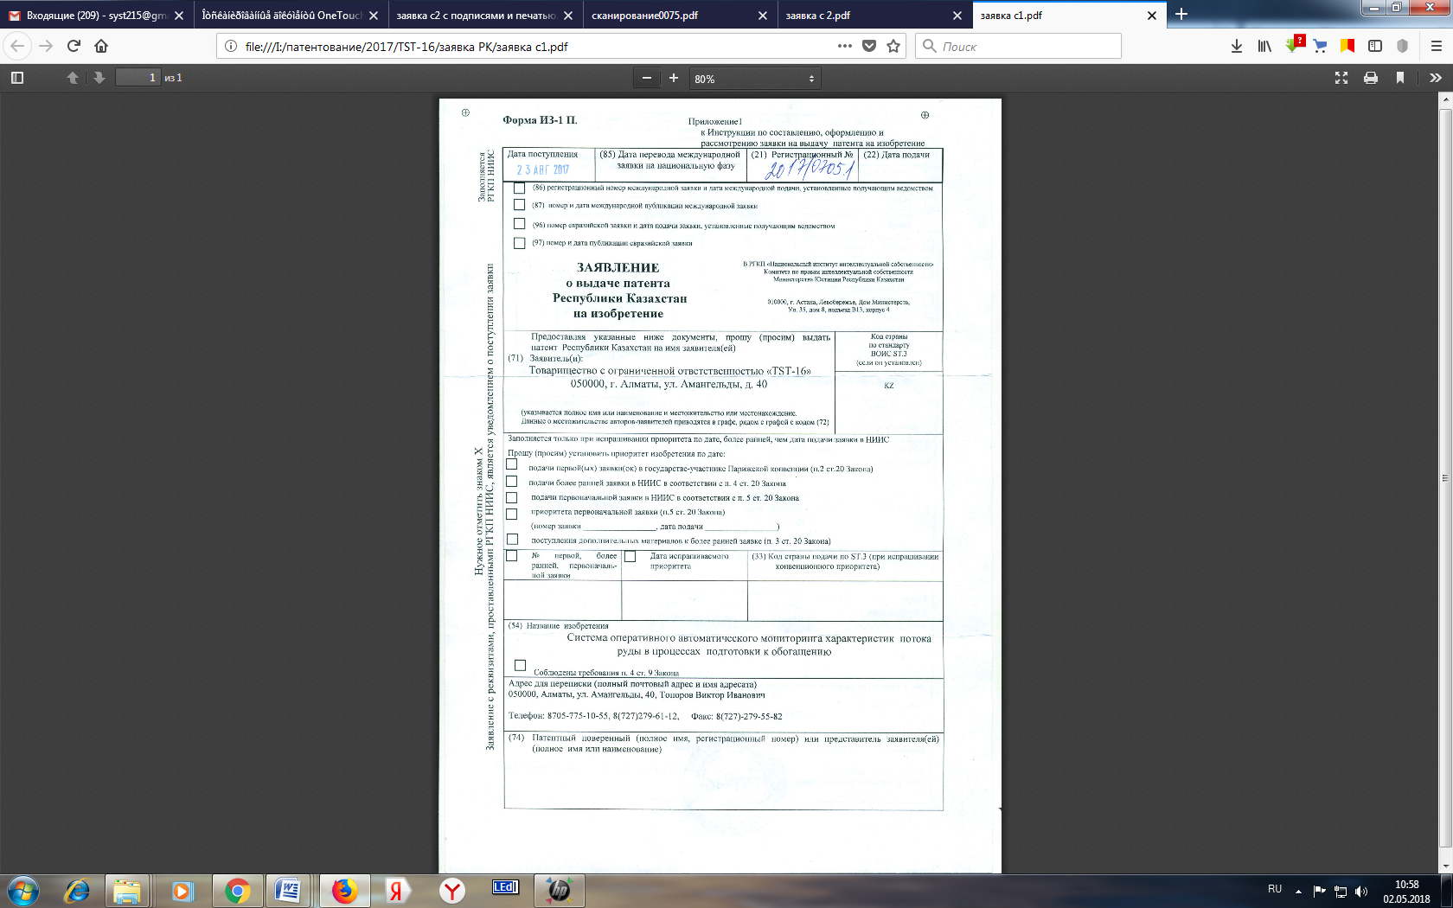
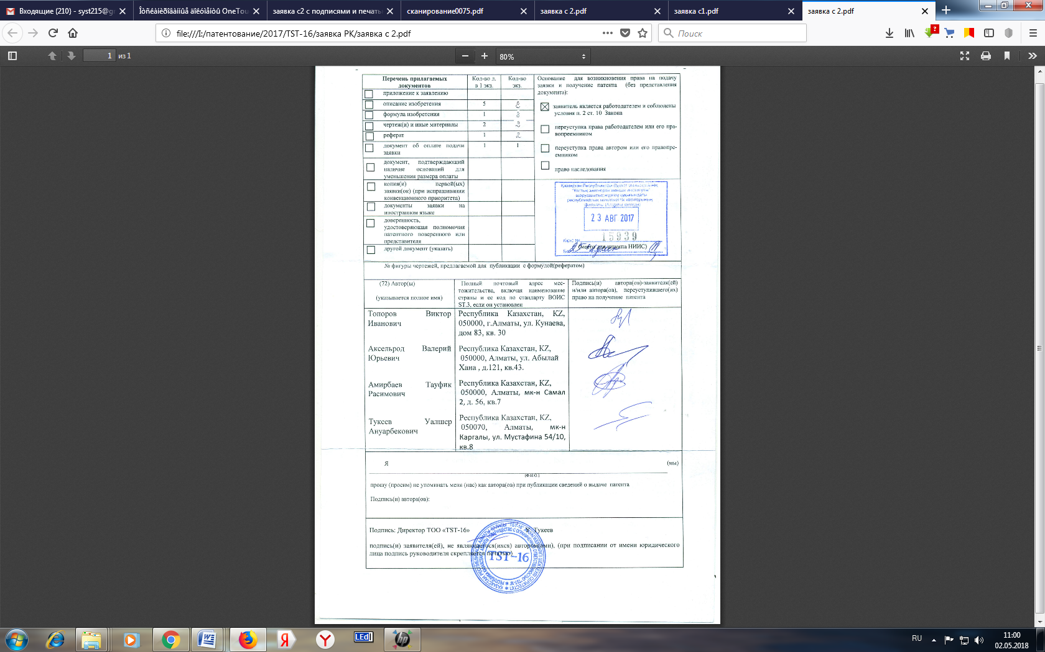
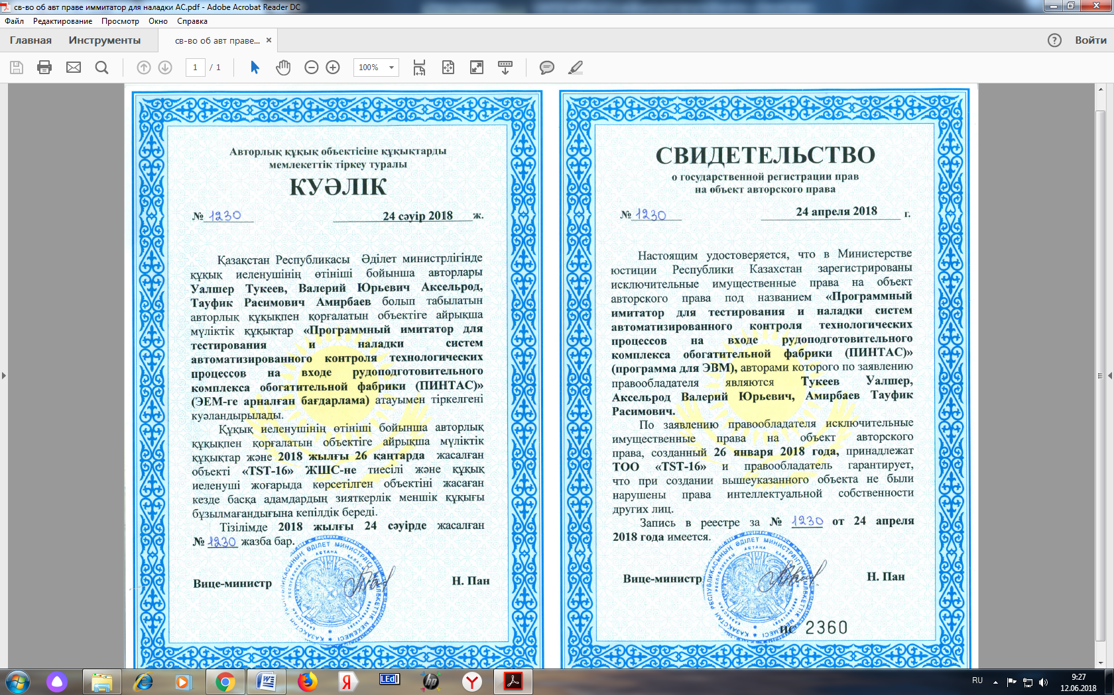
Automated on-line monitoring system of incoming ore flows for mining and processing plants
The status of intellectual property (Certificates and patents for the system)

Slide 16
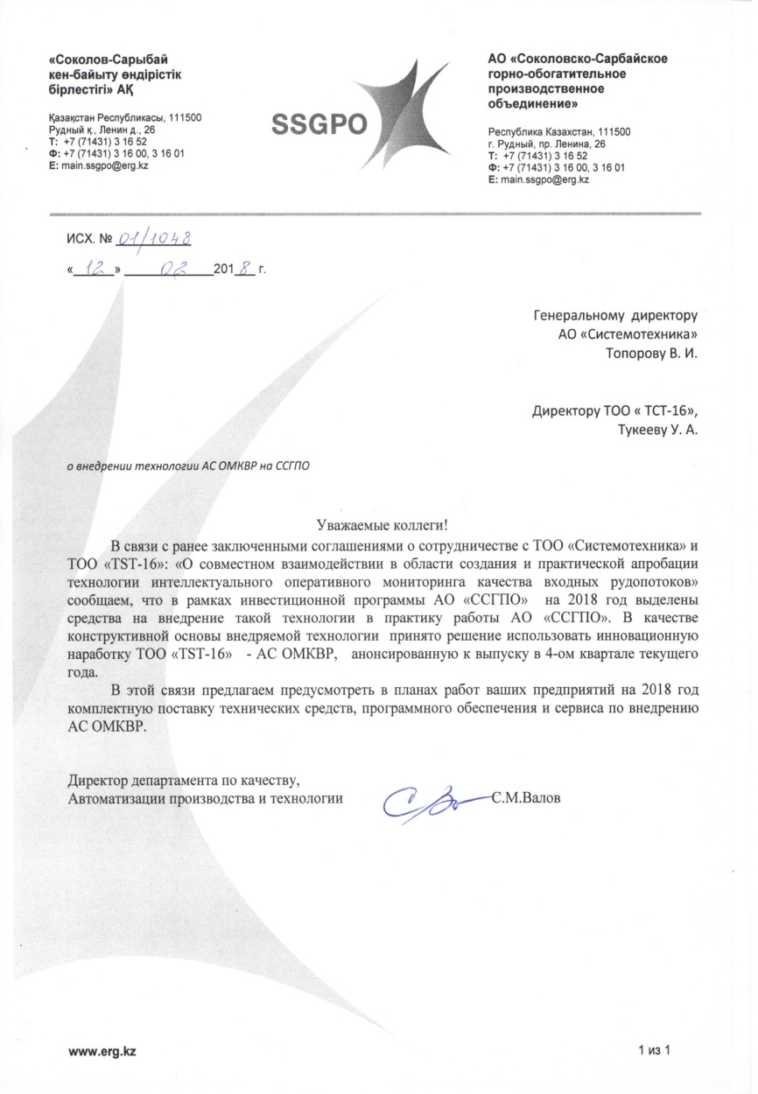

Automated on-line monitoring system of incoming ore flows for mining and processing plants
Current status of the contract for supply the technology of operative monitoring

Slide 17
Автоматизированная система оперативного мониторинга качества входных рудопотоков горно-обогатительного производства
Текущий статус по ДОГОВОРУ на поставку на технологии АС ОМКВР

