Slide 1




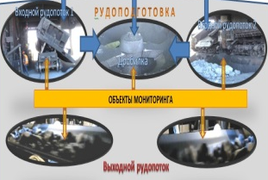

AS ICQO
Business plan
«TST-16» LLP
Project Leader: Tukeyev U.A.
Project number: APP-SSG-16/0330P
Technology: AS ICQO
Grant amount : 195 000 000 KZT
Co-financing amount : 5000000 KZT

Slide 2
Problems of systems of monitoring of ore flows
  Market needs
For the effective functioning of mining and processing enterprises, it is necessary to have operational information about the characteristics of the ores received for processing in real time. It is important, in pace with the processes of reception and processing of raw materials (real time), to ensure:
  Operational accounting of the volume and quality of ore mass flows entering for processing
  Coordination of mining and processing of mining and industrial enterprise
  Informational support of the operational management of the technological chain of ore processing at all operations of the ore preparation complex, from large-scale crushing to the production of finished products
  Control over the execution of technological procedures for ensuring the quality of the stockpiles of incoming ore
    Description of the problem and its significance
    Existing monitoring technologies provide qualitative and quantitative characteristics of ore flows in real time only for fine fractional flows (piece size not more than 50 mm) and for a single-flow scheme of their receipt for processing. The proposed solutions for the adaptation of such technologies for a multithreaded scheme and a large more than 250 mm size of pieces of minerals in the stream are associated either with an almost linear increase in investment in the technical means of the monitoring system or with a decrease in the monitoring efficiency. That is, the creation of monitoring systems based on existing technologies is both expensive and unpromising.
    Inputs
    It is necessary to develop new, intelligent, affordable and meeting the needs of the market monitoring systems. Next, considered a commercial product of the AS ICQO as a solution to the problem of the market for products of operational monitoring of ore flows

Slide 3
Existing solutions to the problem
How the problem is solved now
At present, the problem of monitoring the flows of lumpy ore at the GOK is solved as follows:
  If the scheme of receipt of ore raw materials for processing is single-flow (raw materials from different mines or quarries are recycled sequentially), measurements are carried out after the first technological operation for its processing - crushing, where the condition of small fractionality is a priori.
  If there are several commodity flows (a multi-flow scheme for the receipt of raw materials), then the condition for the identity of quality indicators for raw and crushed flows is violated. Then, they either distinguish a representative part of the raw material stream coming in for processing and make it small fraction before measurement, or by dispatching they separate the moments of receiving raw materials from different sources, turning the multi-stream into a sequence of monostreams.
Why existing solutions to the problem do not meet the needs of the market
The technologies of input control of flows of mineral raw materials used in practice are not sufficiently operational and are focused on monitoring of fine fractional flows and a single-stream scheme for their receipt for processing.
Adaptation of existing technologies for multithreaded schemes leads to an increase in monitoring time or a linear increase in the cost of the corresponding complex of technical means.

Slide 4
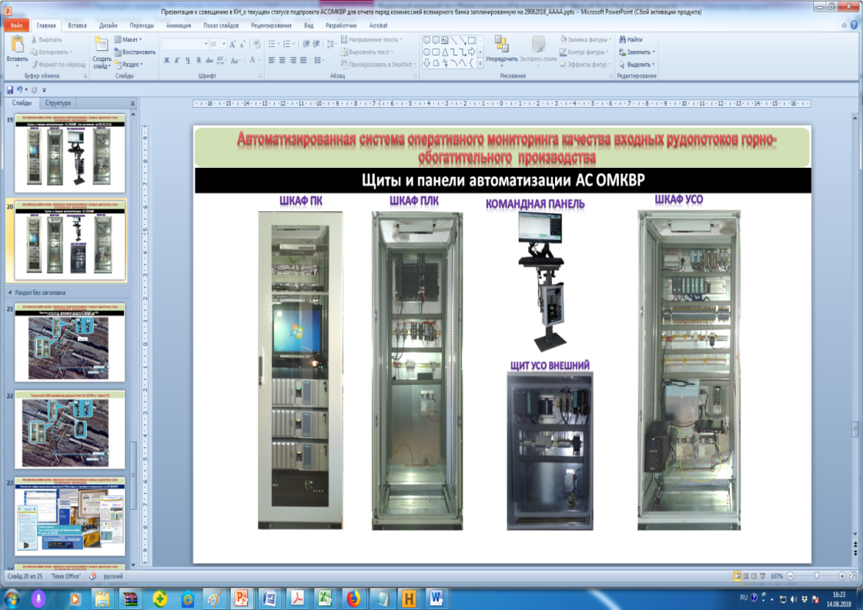

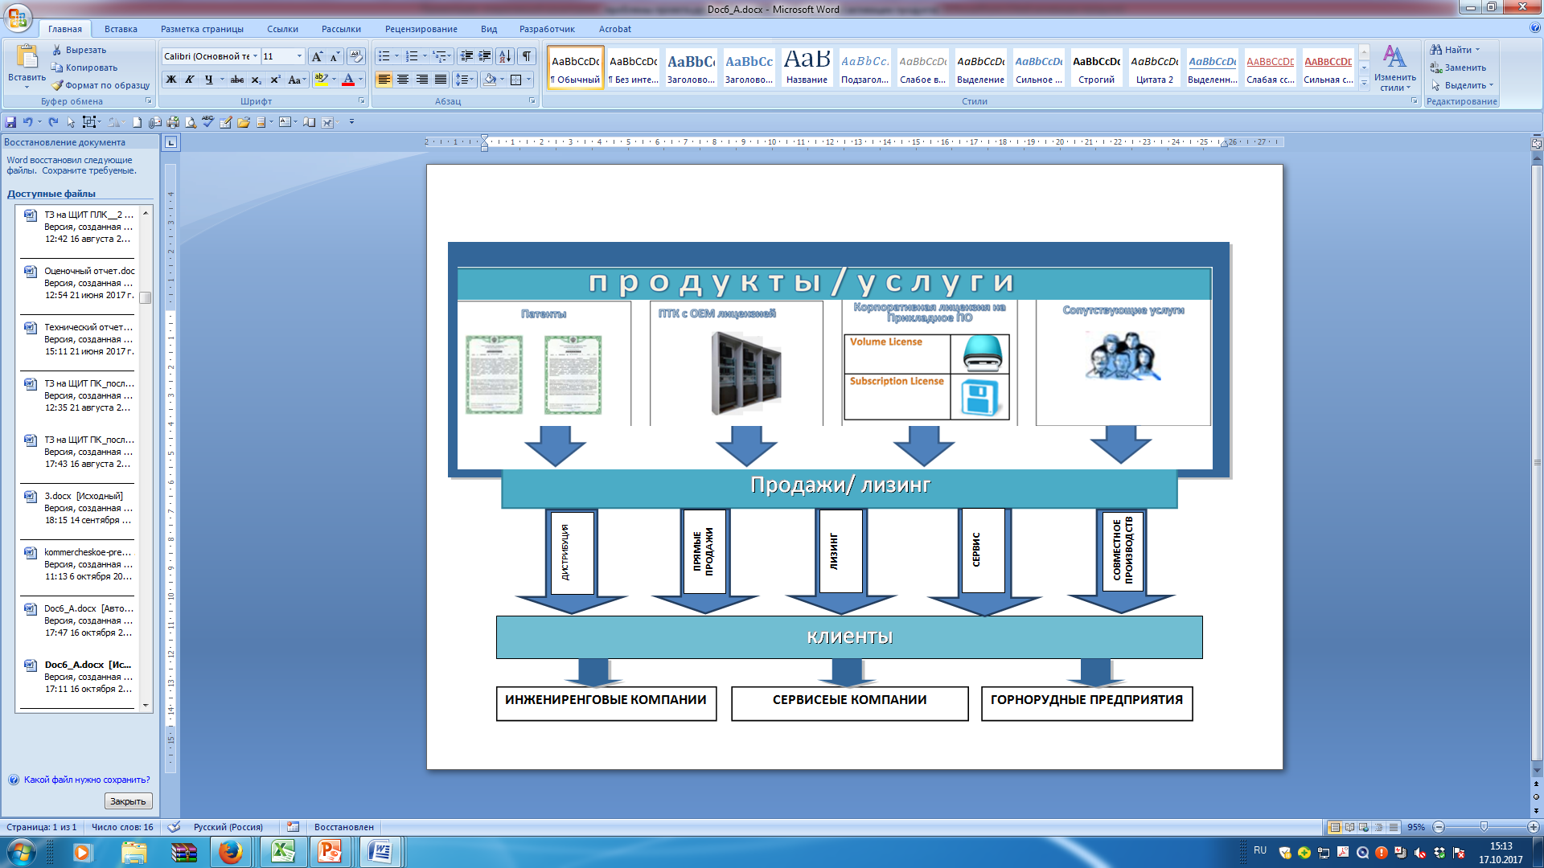

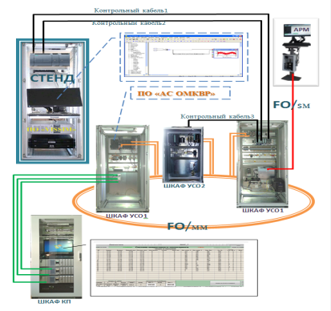
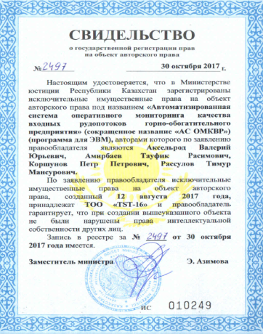
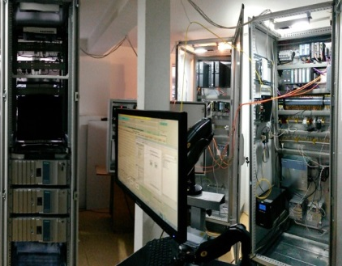
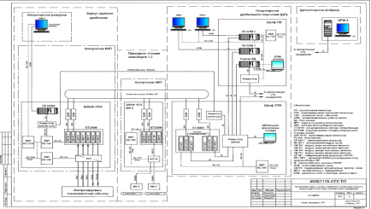
Proposed solution
AS ICQO
HardWare
AS ICQO
Software
A set of products based on the proposed technology
The technology is delivered to the market as a basic set of software and hardware, ready for use both individually and as part of an automated operational monitoring system (AS ICQO). Related services are also subject to the market (see the next slide).
Functions implemented in the framework of the proposed solution
The set of technology products implements the following functions:
      Input control of volumes and quality of large-scale flows of raw materials of an enterprise in real time, taking into account a multithreaded processing scheme
      Informational support for accounting of cost-accounting relations between the mining and processing areas of the mining processing enterprise
      Formation of summary data and reports to coordinate the work of the production chain “mining-crushing-enrichment”
Principle of monitoring based on the proposed technology The principle of monitoring based on the proposed technology is fundamentally different from those offered on the market. Instead of direct measurements of the qualitative and quantitative characteristics of lumpy ore flows at the input of the ore preparation, the measurements and analytical processing of similar indicators of the mixed discrete-continuous ore flow after the crushing operation are made taking into account its temporal characteristics and chronology of formation.
Structure
Copyright
Assembly for adjustment on the ground
Design Solutions

Slide 5
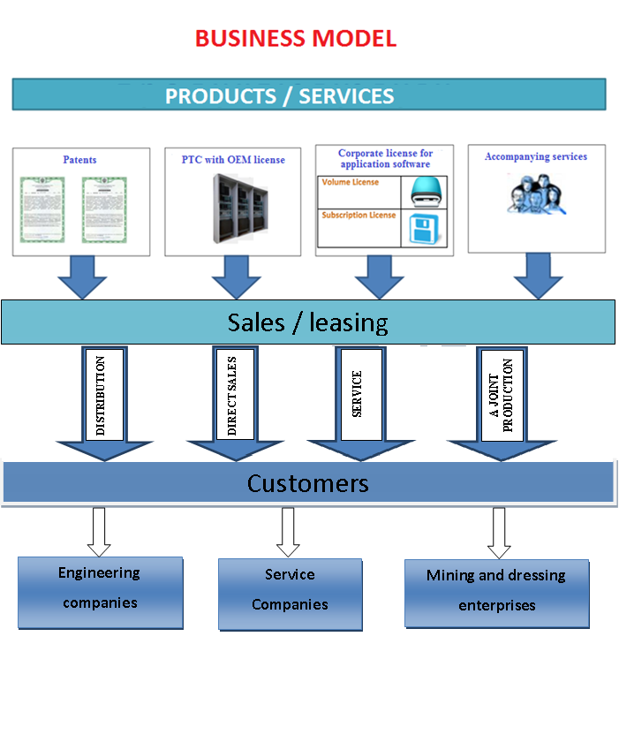
Products and sales scheme

Slide 6
Competitive advantages of the proposed solution
Guaranteed acceptable accuracy of estimates of the characteristics of the ore flow in real time and with a single point of control.
High efficiency of estimates of the characteristics of ore mass fluxes coming from different mines and quarries
The high level of readiness of the proposed products for use due to their mandatory pre-sale testing at a specialized stand with a control set of real chronologies of the dynamics of the formation of input flows of raw materials of the enterprise.
Possibility to use any stream analyzers of raw materials in the monitoring system (including those already operated in the enterprise)
Flexible sales strategy for products / services ensuring the scalability of customer costs for creating or upgrading a system for automated monitoring of raw material flows in real time
There is no need for on-line measurements of the characteristics of the ore fluxes at the inlet of the enrichment area, which is a problem for most analyzers.
Increasing the throughput capacity of the ore-receiving complex of the concentration plant without additional investments due to the lack of need for individual control of the ore flow at its entrance.

Slide 7
Comprehensive assessment of the proposed monitoring technology
Market segments
Industrial automation systems in the areas of:
Mining and processing of mineral raw materials
Production of building materials and dry mixes
Customer needs Accounting for the volume and quality of raw material flows from the quarries in real time Ensuring the operational coordination and rhythm of the technological conversion of enterprises for the extraction and processing of mineral raw materials. | Problems The technologies used in practice are not sufficiently focused on monitoring of small-fractional flows with a single-flow scheme for their receipt for processing. Adaptation of existing technologies for multithreaded schemes practically leads to a linear increase in the cost of a set of technical means of the monitoring system.
Decision
Using the proposed technology
The essence of technology Instead of direct measurements of the qualitative and quantitative characteristics of the lumpy ore flows entering the beneficiation plant, measurements and analytical processing of similar indicators in a mixed discrete-continuous ore flow after crushing are made, taking into account the temporal characteristics and the history of its formation.
Technical readiness The technology is in the process of practical testing after completion of the refinement and design work. Based on the developed technical documentation, a set of technical equipment was purchased and installed. Made his adjustment and test tests in the ground conditions of the technology holder. Work is underway to prepare for approbation of technical solutions and equipment in an industrial environment. Completion of industrial testing - until the end of 2018
Motivation of choice for users Monitoring the quality of ore raw materials of the processing plant in real time. Operational management of the technological chain "mining-crushing-enrichment". The ability to organize the management of the quality of finished products in real time. An objective informational basis for cost accounting between mining and concentration processing. Reducing the cost of creating a system of monitoring ore flows. Domestic manufacturer.

Slide 8
Market opportunities
Potential customers and target market size
1. In the near future, the potential buyers of products of the ICQO AS may be enterprises of the Republic of Kazakhstan and the Russian Federation
2. The size of the market for the products of the OMKVR AS for the next 10 years may be approximately 800,000.0 thousand tenge.
Potential Clients in the Republic of Kazakhstan | Potential Customers in the Russian Federation
Kazakhmys Corporation, JSC "Donskoy GOK", JSC SSGPO, JSC "Zhairem GOK", JSC "Zyryanovsky GOK“ Kazakhcement LLP, LLP "FC Asbest“ OJSC Kustanaiasbest Automation engineering company GOK etc; | Mikhailovsky GOK, Stoilensky GOK Lebedinsky GOK JSC "Apatite“ OJSC Norilsk Nickel Uchalinsky GOK Ahtalsky GOK Tominsky GOK Automation engineering company GOK etc;

Slide 9
Business model
Key partners Sistemotekhnika LLP ”- participation in financing and ensuring the rights of access to the scientific and engineering fundamentals of the ICQO AS Software and hardware complex SSGPO JSC - technical assistance during construction and installation, commissioning and commercialization products testing PMU on the Innovative Promotion Program
Key processes Search for buyers. Sales. Services to bind the basic project. Construction and installation work. Commissioning works.
Value proposition Monitoring the quality of ore raw materials of the processing plant in real time. Data acquisition for the operational management of the production-enrichment process chain. Creation of an adequate information base for cost accounting between mining and mineral processing. Reducing the cost of creating systems for monitoring mineral resource flows
Customer Relationship Technologies Production Provision of services Licensing Direct sales Leasing
Target consumer Groups Mining complex Metallurgy Production of mineral raw materials Production of building materials Engineering companies
Key Resources Industrial base: Premises Development tools Instruments, Devices, Software from TST-16 Specialists (Designers, programmers, installers)
Promotion Channels PR actions through the media Address offers Distribution
Cost structure, thousand tenge
Article / Year | 2017 | 2018 | 2019 | 2020 | 2021
Salary | -18 360 000,0 | -29 339 400,00 | -12 903 023,00 | -9 204 996,00 | -9 849 345,72
other | -4 720 000,0 | -6 060 480,00 | -6 484 713,60 | -6 938 643,55 | -7 424 348,60
Taxes | -1 768 250,0 | -11 079 498,87 | -5 820 526,77 | -9 384 305,91 | -22 370 498,27
Cash flows, thousand tenge
Article | 2017 | 2018 | 2019 | 2020 | 2021
Operating activities | -24 848 250,00 | 2 520 621,13 | 791 736,63 | 13 472 054,54 | 43 355 807,41
Investment activities | 0,00 | -33 443 600,00 | -6 100 000,00 | 0,00 | 0,00
Financial activities | 24 883 250,00 | 72 597 839,89 | 29 074 484,42 | 16 514 914,62 | 19 226 325,58
Total cash flow | 35 000,00 | 41 674 861,02 | 23 766 221,05 | 29 986 969,16 | 62 582 132,99
Cumulative funds | 35 000,00 | 41 709 861,02 | 65 476 082,08 | 95 463 051,23 | 158 045 184,23

Slide 10
Marketing strategy
Sales Options
Products | Sales options for products / services | Factors for choosing a market segment
Technology patents. Software and hardware complex with an OEM license. Application Software Licenses Accompanying services. | Distribution Direct sales Leasing Service maintenance Co-production | Types of consumers Mining enterprises; Building materials manufacturers; Engineering companies Consumer return rate High Average Low Sales territory Kazakhstan The Eurasian Economic Union countries Far abroad
Sales strategy for distribution option "DISTRIBUTION"
Product / Service | Segmentation factors
 | Types of consumers |  |  | Consumer return rate |  |  | Sales territory
 | 1.1 | 1.2 | 1.3. | 2.1 | 2.2 | 2.3 | 3.1 | 3.2 | 3.3
1 |  |  | + | + | + | + | + | +
2 | + |  |  | + | + | + | + | +
 |  | + |  | + | + |  | +
3 | + |  |  | + | + | + | + |  | +
 |  | + |  | + | + | + | +
 |  |  | + | + | + | + | + | +
4 | + |  |  | + | + | + | + | +
 | + |  |  | + | + | +

Slide 11
Competition
Company | Product | Type of product | Purpose of the product | The composition of the product | Sensor installation location | The possibility of using for multi-flow scheme of ore receipt at the factory | Price range, thousand USD
LLC "Uralrudoavtomatika" |  | Software and hardware complex | On-line monitoring of the volume and quality of ore flow | Branded Analyzer of Flow Quality Workstation of an specialist | Any point in the process "mining - enrichment" where the uniqueness of compliance "flow - mine" is not violated | Only if there is an installation in the monitoring system for obtaining a representative sample of finely crushed ore for each measured lump stream | More than 200 000
LLC "Technoros" |  | Software and hardware complex | On-line monitoring of the volume and quality of ore flow | Branded Analyzer of Flow Quality Workstation of an specialist on windows-platform | Any point in the process "mining - enrichment" where the uniqueness of compliance "flow - mine" is not violated | Only when installing individual sensors on each measured flow and integrating the relevant collection and analysis systems into a single analytical system | More than 170 000
"ТST-16" LLP | AS ICQO | Software and hardware complex | On-line monitoring of the volume and quality of ore flow | Flow quality analyzer from any company Information-analytical subsystem based on PLC Workstation based on SCADA | Conveyor after major crushing. Unambiguous match-mine flow is not required. The fineness conditions are automatically met. | Only one sensor and a single analytical unit of the analysis system are sufficient, regardless of the number of sources of ore input for crushing | More than 150 000
"ТST-16" LLP | AS ICQO SoftWare | Licenses for software | Software for monitoring the volume and quality of ore flow on-line | Application software for PLC and SCADA as part of the AS ICQO | - | Fully provides the necessary functionality of the on-line monitoring system for multi-stream schemes for the receipt of ore masses on ore preparation | Up to 10 000

Slide 12
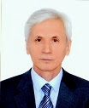
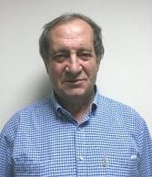
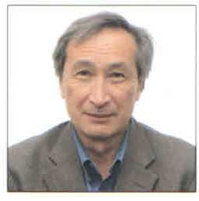
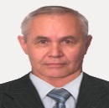
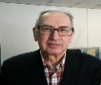

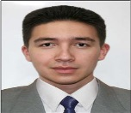
Team
№ | Full name | PHOTO | position | Duties | Scientific status / experience | Percent of participation
1 | Tukeyev U. A. |  | TST-16 Director, Project Team Leader | IT specialist. Identifies the main scientific and engineering aspects of the work performed, leads the development. | Doctor of Technical Sciences, Professor. Author of more than 155 articles, one monograph, four textbooks. | 100
2 | Axelrod V.Yu. |  | Specialist in commercialisation | Specializes in marketing and project management. He is responsible for planning the work of team members and third-party organizations, oversees the sale of products. | Co-authored two monographs, a number of patents of the Republic of Kazakhstan and the Russian Federation for inventions, more than 20 publications in scientific journals. | 100
3 | Korshunov P.P. |  | Engineer / Technologist | Specialist in the development of technical support systems for industrial automation. Responsible for the quality and completeness of project documentation and technical support of the AS. |  | 100
4 | Amirbayev T.R. |  | Senior Scientist Group | System Analyst. Responsible for the development of technical requirements, tasks, formulation of applied problems, the development of functional specifications. Develops plans and methodological research and development programs. | Candidate of Technical Sciences, an expert in the field of automation and remote control. | 100
5 | Zemlyansky V.P. |  | Engineer / Technologist | Specialist in the field of digital technology and instrumentation. Responsible for technical and instrumental works. |  | 70
6 | Shchepina M.P. |  | Engineer / Technologist | The system analyst is responsible for the design and ergonomics of the user interface. |  | 70
7 | Rassulov T.M. |  | Engineer / Technologist | Programming Specialist. Performs the development of mathematical and software systems for operational monitoring. |  | 70

Slide 13
Strategic partners
LLP " Systemotechnika " - a company specializes in information technology, software development and automation systems; has more than 30 years of experience in the development and implementation of systems in the field of metallurgy, ore dressing, chemistry, and light industry.
Sokolov-Sarybai Mining Production Association (SSGPO) JSC is the largest mining enterprise in Kazakhstan, part of the Eurasian Resources Group (ERG). The main activity: open-pit and underground mining of iron ores, production of iron ore pellets and concentrate, mining and production of commodity dolomite, production of crushed stone, oxygen, steel, liquid, iron and steel casting.
EXPERTS
Salikhov Zufar Garifullovich. Doctor of Technical Sciences, Professor, Honored Scientist of Russia, Academician of the RAIN and IANB, Chief Researcher at the Institute for Management Problems of the Russian Academy of Sciences.

Slide 14
Financial model
The main forecasts of our business with a depth of 5 years. Summary of performance
Total cost of the project, tenge |  | 165 552 655
Net present income of the project, tenge | NPV | 1 510 825
Internal rate of return,% | IRR | 14,248%
Payback period, months | PB | 59
Discounted payback period, months | DPB | 59
Project profit, tenge |  | 75 102 910
Cash balance at the end of the project, tenge |  | 208 392 641
The main forecasts of our business with a depth of 5 years. Cash flows
Article | 2017 | 2018 | 2019 | 2020 | 2021
Operating activities | -24 848 250,00 | 2 520 621,13 | 791 736,63 | 13 472 054,54 | 43 355 807,41
Investment activities | 0,00 | -33 443 600,00 | -6 100 000,00 | 0,00 | 0,00
Financial activities | 24 883 250,00 | 72 597 839,89 | 29 074 484,42 | 16 514 914,62 | 19 226 325,58
Total cash flow | 35 000,00 | 41 674 861,02 | 23 766 221,05 | 29 986 969,16 | 62 582 132,99
Cumulative funds | 35 000,00 | 41 709 861,02 | 65 476 082,08 | 95 463 051,23 | 158 045 184,23

Slide 15
Conclusion
Solution: Informational and analytical complex for one-time monitoring of large-scale ore mass flows of ore preparation production in real time. The means of monitoring large-scale flows on the market with a multithreaded scheme of their receipt for processing are not effective, since their use either leads to a linear increase in the cost of technical equipment or to a decrease in the efficiency of monitoring.
Competitive Advantage: Fully provides the necessary functionality of the on-line monitoring system for multi-stream schemes of receipt of ore masses for ore preparation with only one measuring unit and a single analysis system, regardless of the number of streams at a time entering for processing.
Market: Mining complex, Metallurgy, Production of mineral raw materials, Production of building materials, Engineering companies.
Business model: key partners, key processes, customer relationships, resources, consumer groups, product promotion schemes.
Customer Relations: Production, Service, Licensing, Direct Sales, Leasing.
Financial performance
Effective team: the team members are highly qualified industrial automation specialists. The group is headed by a well-known Kazakhstani scientist in the field of IT - technologies and automated and information systems, doctor of technical sciences, professor, full member of the International Academy of Informatization.
Total cost of the project, tenge |  | 165 552 655
Net present income of the project, tenge | NPV | 1 510 825
Internal rate of return,% | IRR | 14,248%
Payback period, months | PB | 59
Discounted payback period, months | DPB | 59
Project profit, tenge |  | 75 102 910
Cash balance at the end of the project, tenge |  | 208 392 641

Slide 16
Thanks for attention!
Contact details
Tukeyev U. A.
Теl. 8(727)2796185, 8-701-406-0328, 8-701-710-6351
E-mail: gsns2016ruk.ut@gmail.com

Slide 17


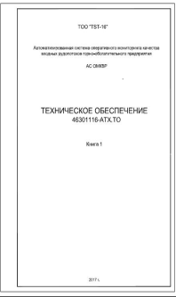



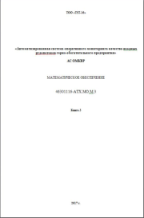
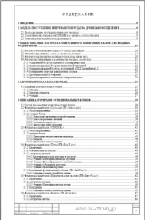
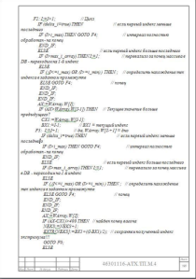
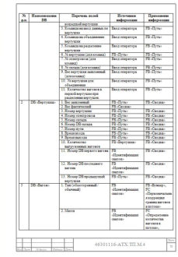
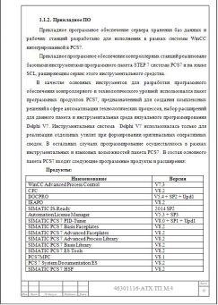
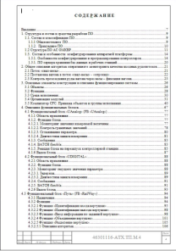
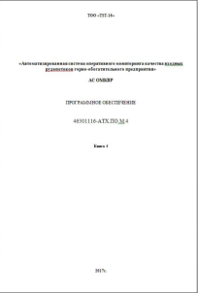


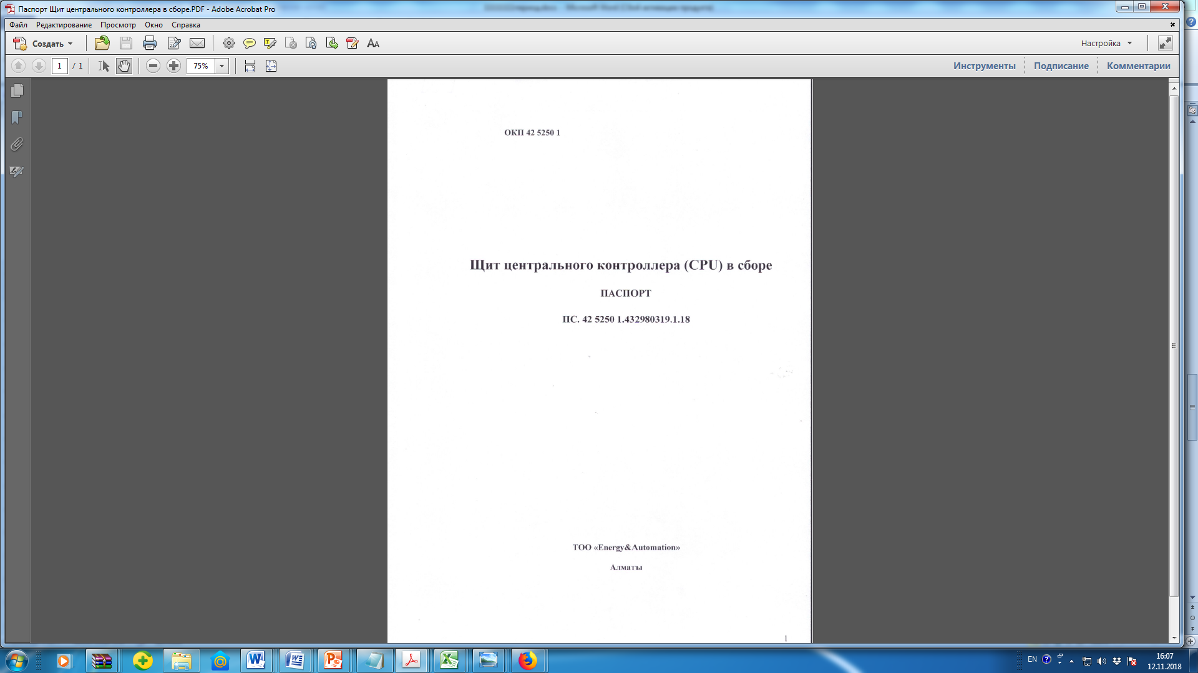
Presale preparation of the ОМКВР
Project documentation and software
Automation cabinets
Application Software Licenses

Slide 18

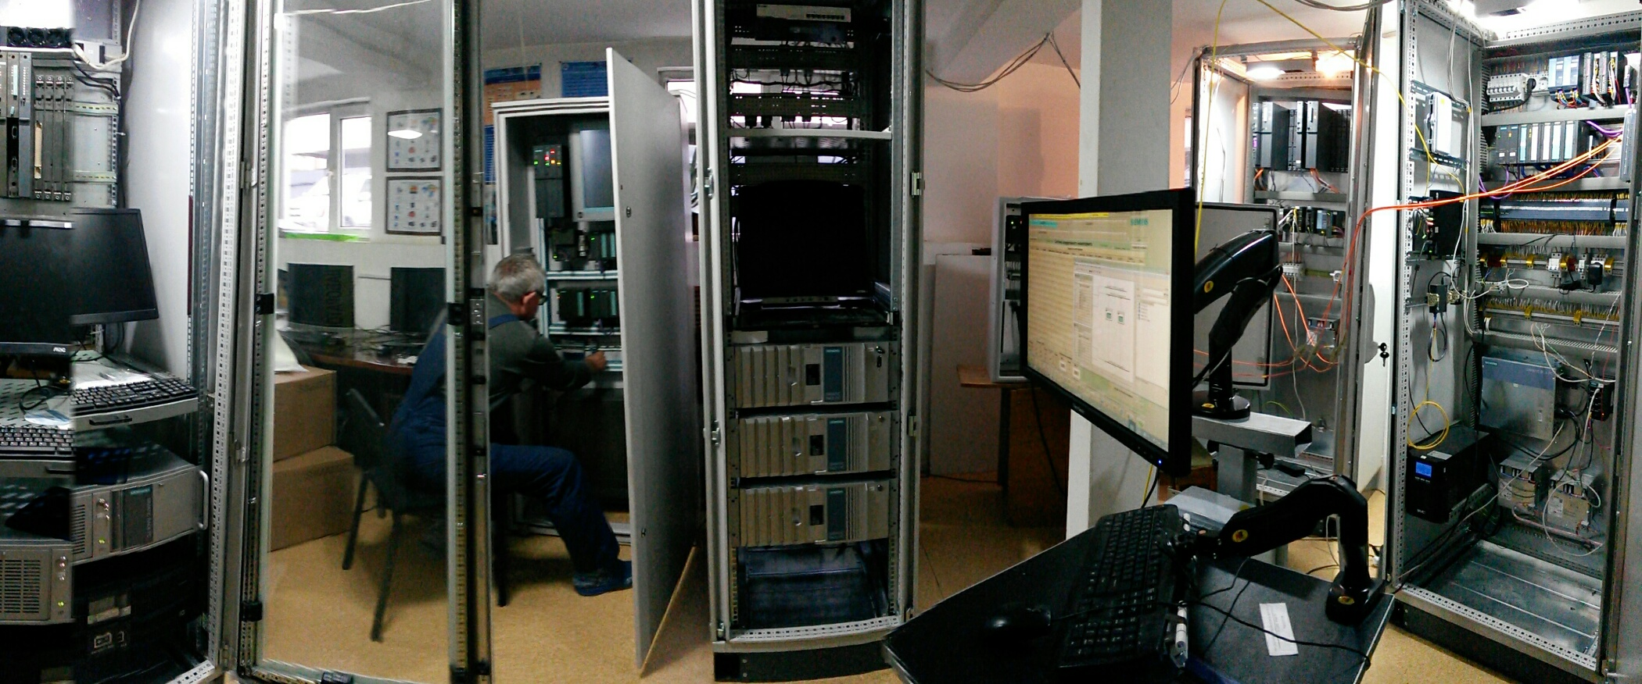
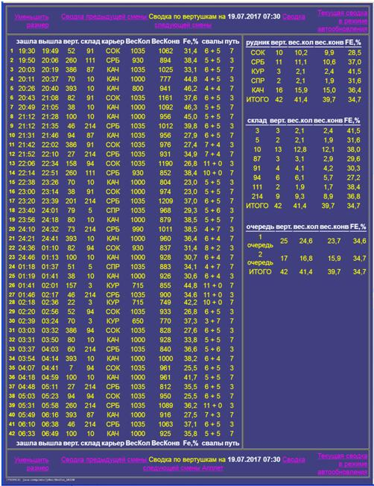
Tests of the OMKVR AS at the stand with real data from the object
real data from the object
SIOD cabinet 1
ADJUSTMENT STAND
SIOD cabinet 2
PLC cabinet
PC cabinet
COMMAND PANEL

Slide 19

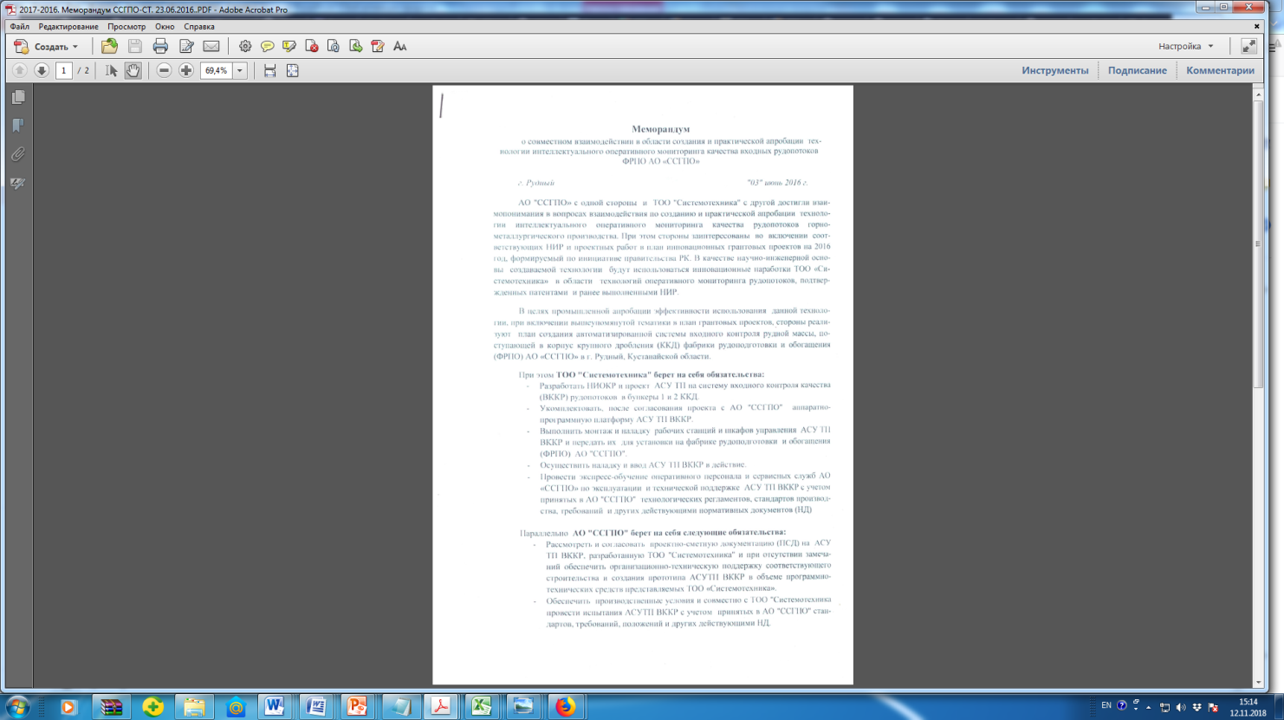
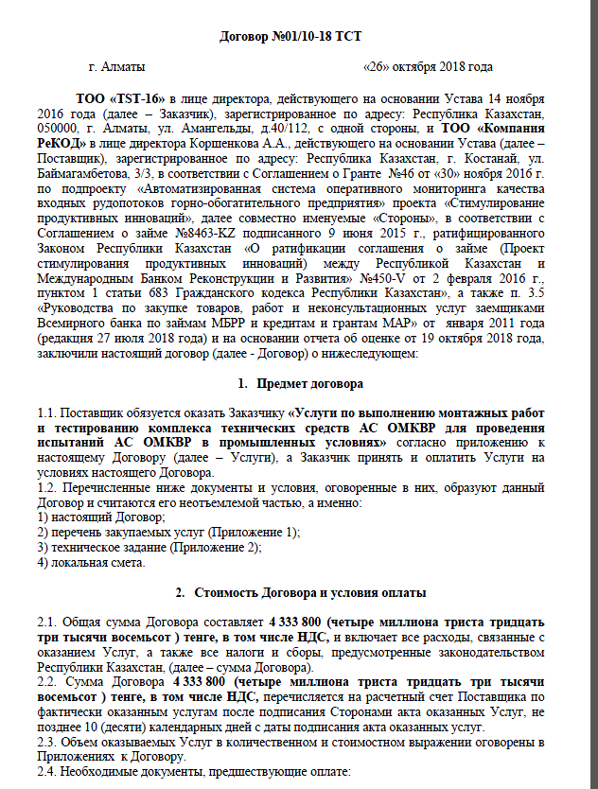
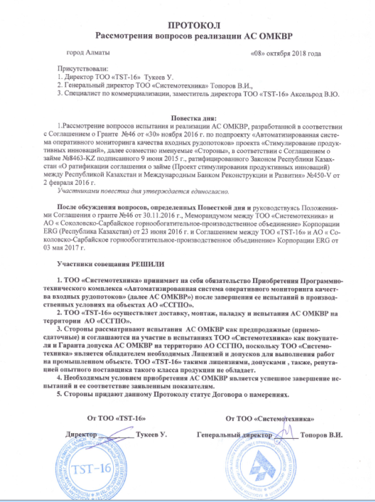
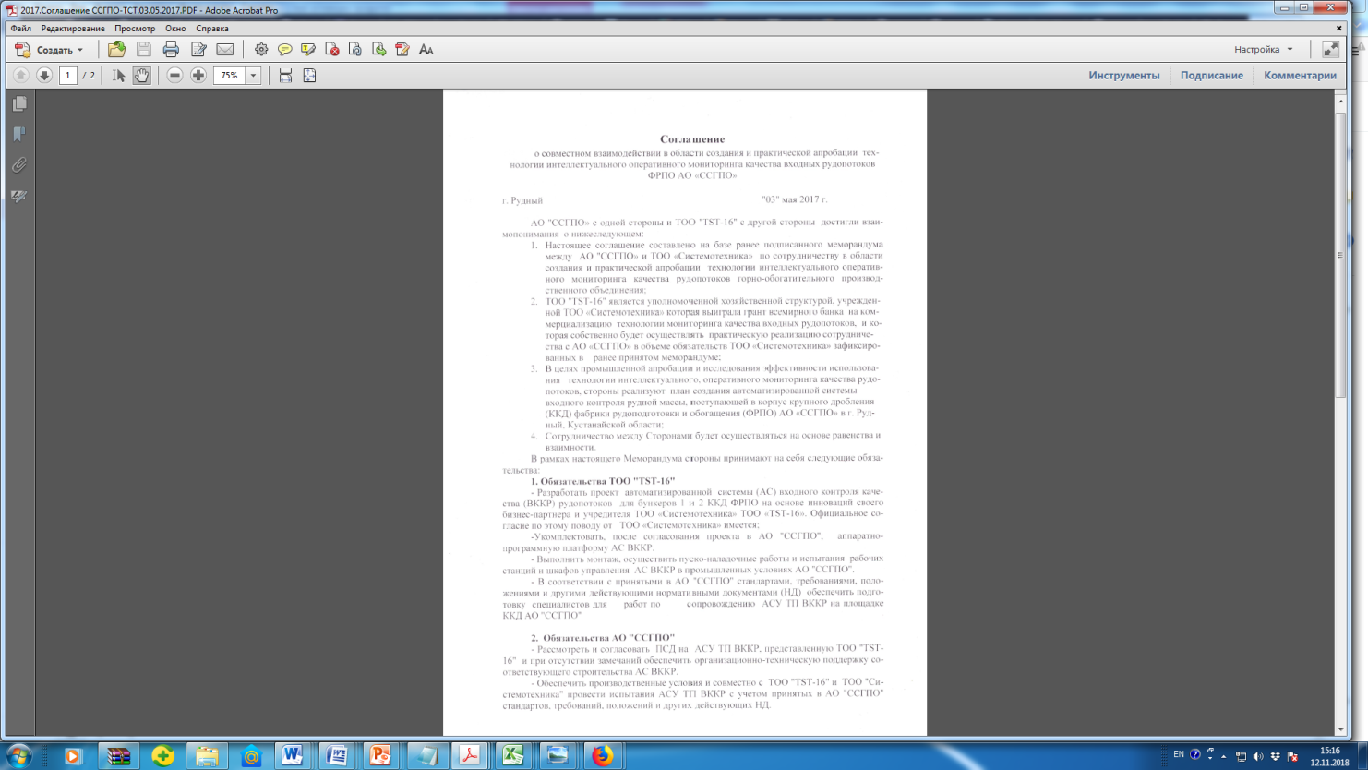
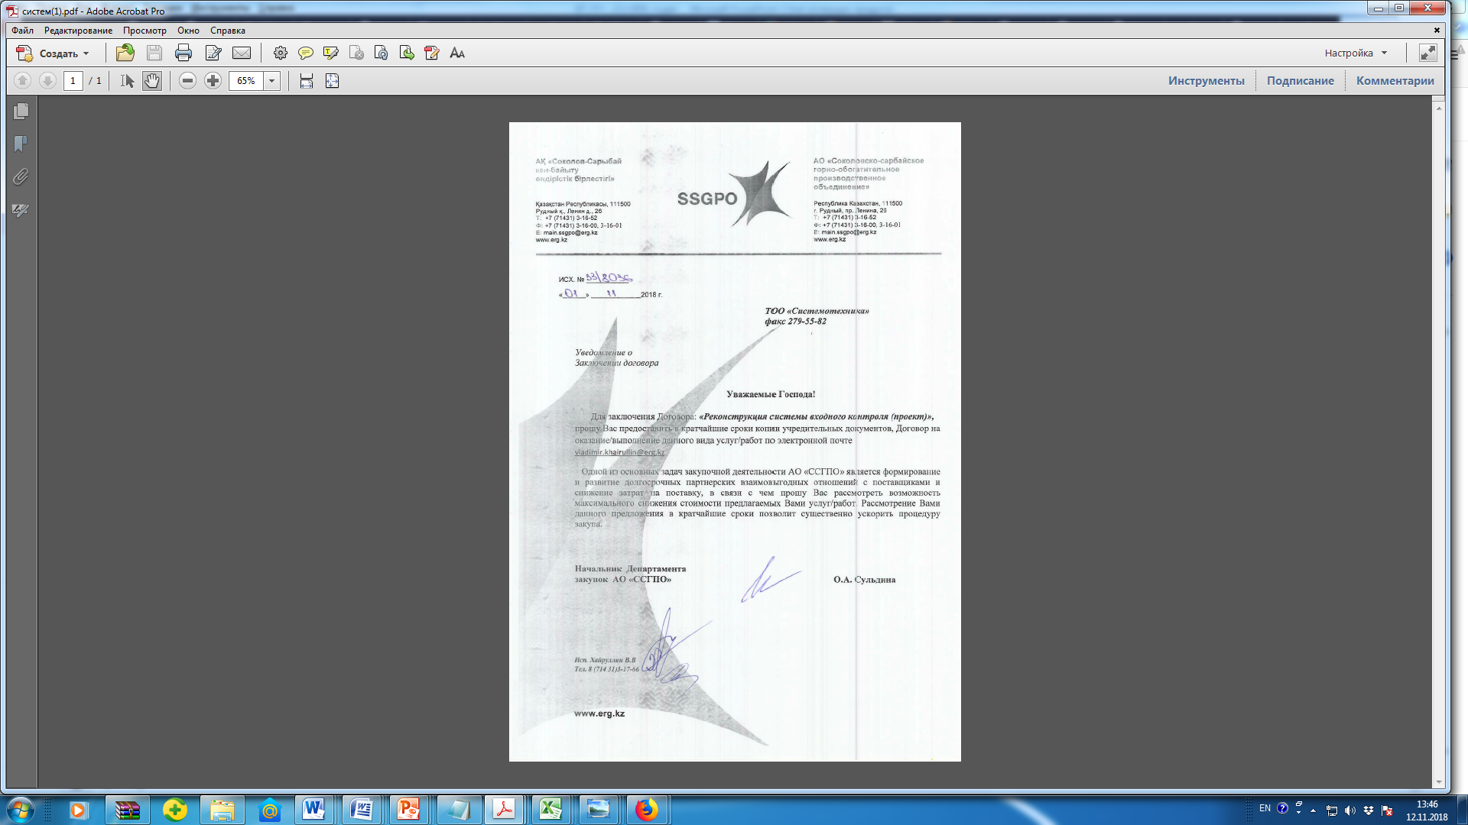
Documentary basis for the Agreement on the supply of OKVR AS
Project documentation and software
Certificate of rights registration to software
Monitoring
technology Patent
Contract with JSC SSGPO
for the supply AS OMKVR
Memorandum of SSGPO JSC – «Systemotechnyka» LLP
on the delivery of the OMKVR AS
Agreement between JSC SSGPO,
LLP "TST-16" and LLP "Systemotechnyka"
for the supply of AS OMKVR

Slide 20
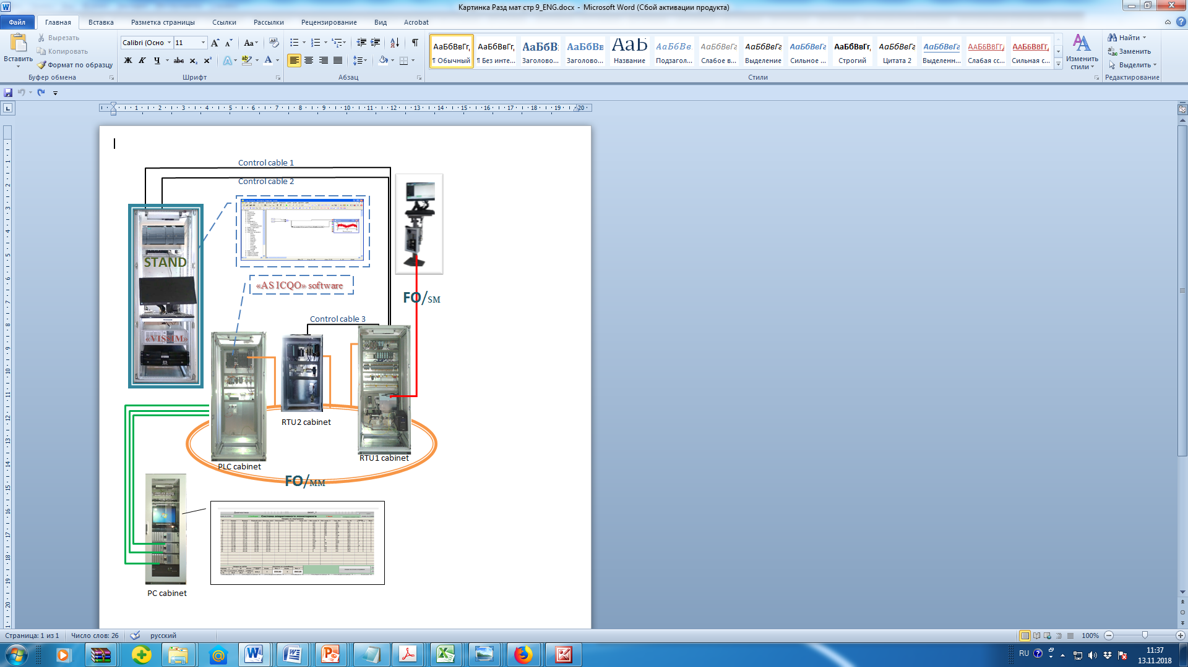
Test setup when using the stand

Slide 21
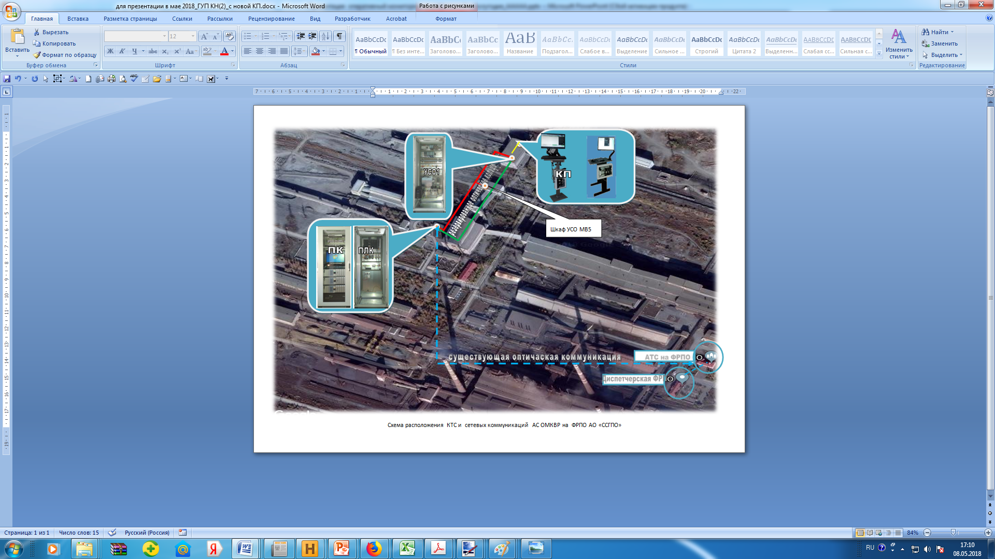
Topology of equipment the monitoring system at the facility

